Slide 1
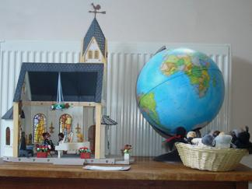

Pray and Play Corners and Busy Bags
Margaret Pritchard Houston
Picture: Victoria Goodman,
The Spiritual Child Network

Slide 2
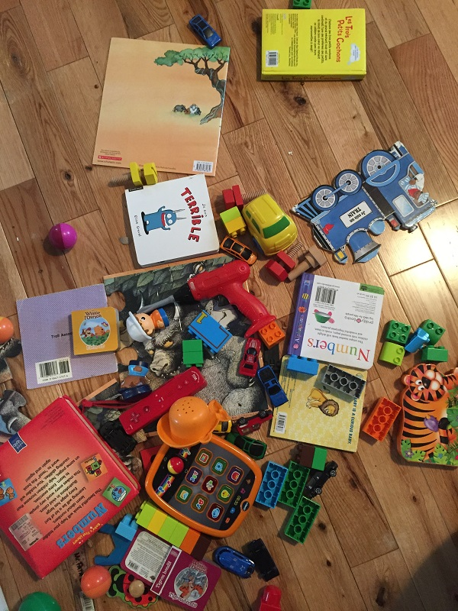

Secular toys
Broken toys
No organisation
Probably also in a dusty back corner of the church, and maybe decorated with a 30-year-old faded banner …

Slide 3
Pray and Play – in church
Break the vicious cycle
Engage the child in symbols and imagery of faith
Story, liturgy, season
Within sight of the altar
Room for parents and carers

Slide 4
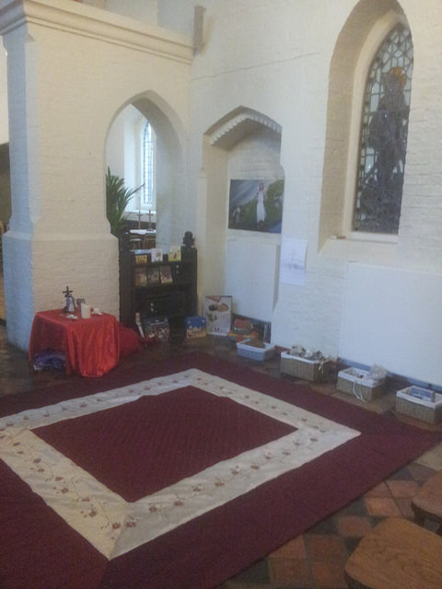
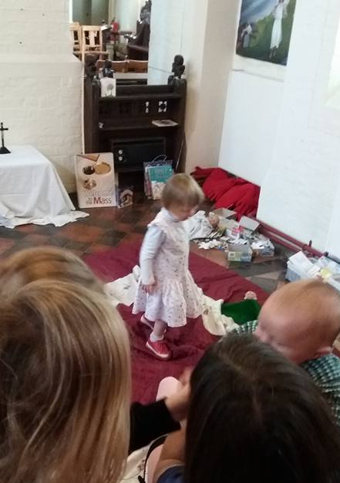

Slide 5
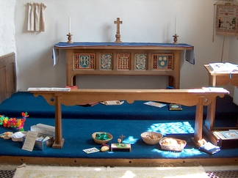

Photo: Spiritual Child Network

Slide 6
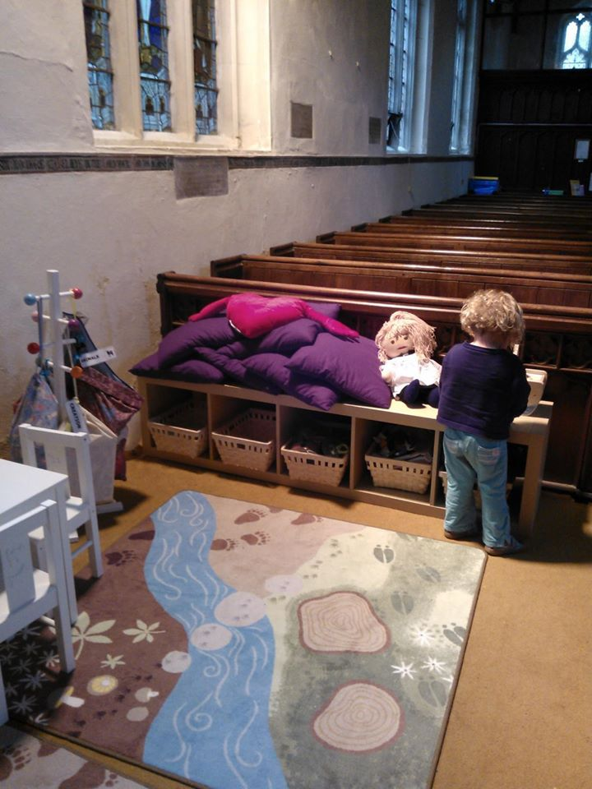
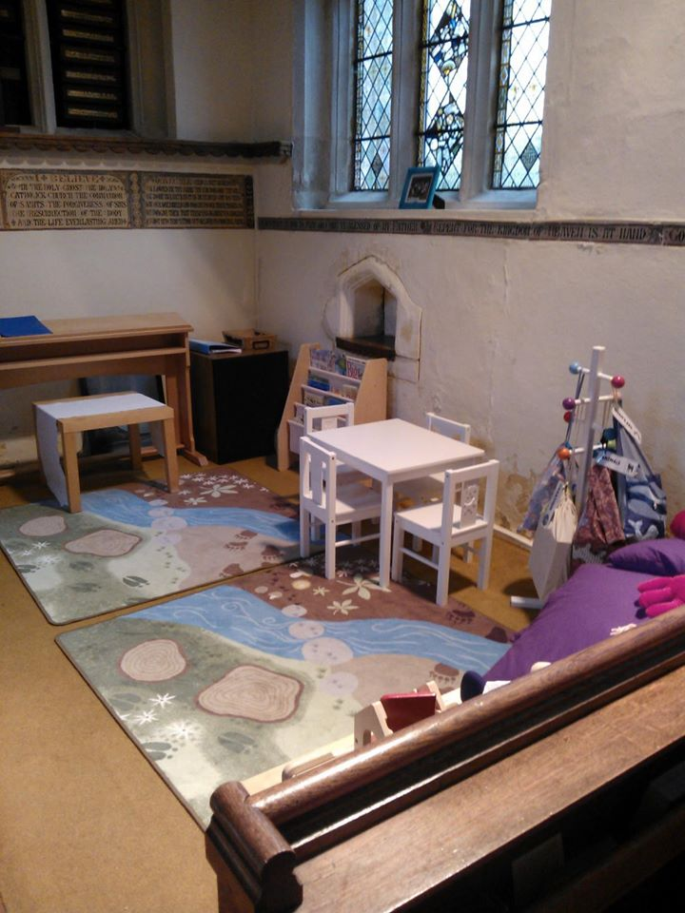

Slide 7
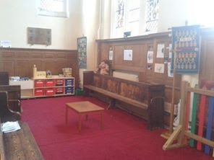
Picture: Eona Bell

Slide 8
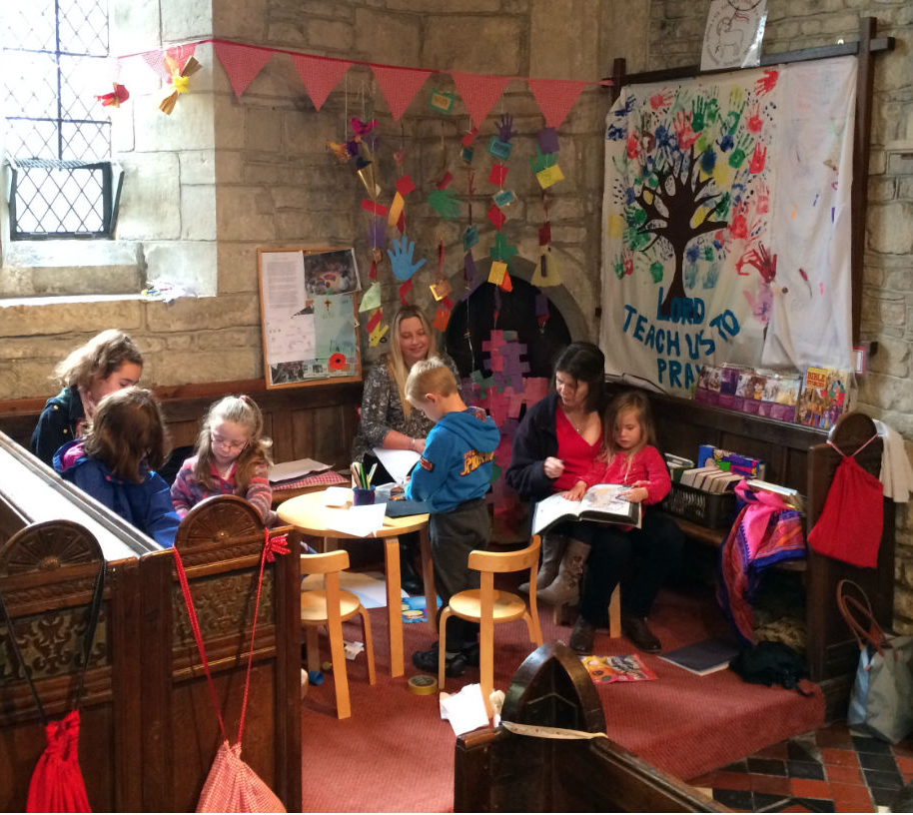
Photo: St John’s Church,
Tisbury, Wiltshire

Slide 9
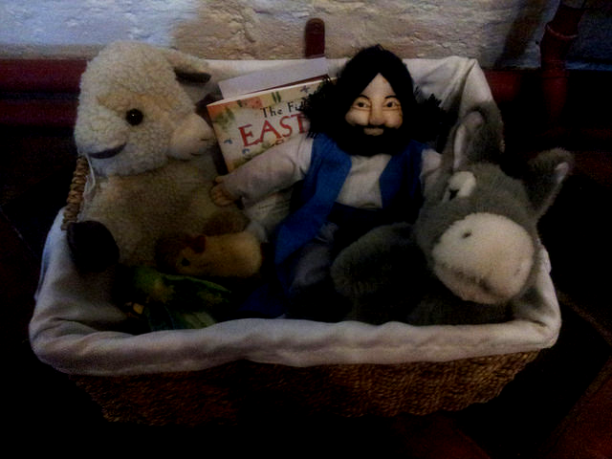
Story

Slide 10
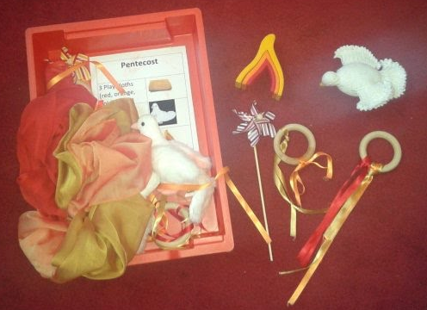
Picture: Eona Bell

Slide 11
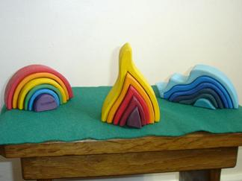
Photo: Victoria Goodman, Spiritual Child Network
http://www.spiritualchild.co.uk/cahsacredspace.html

Slide 12
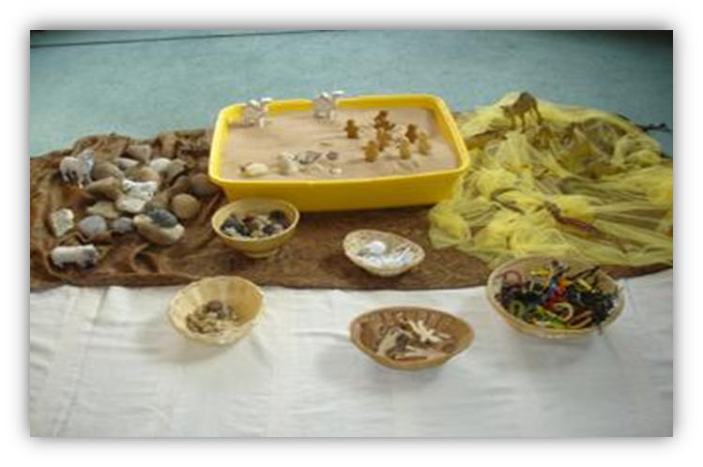


Slide 13
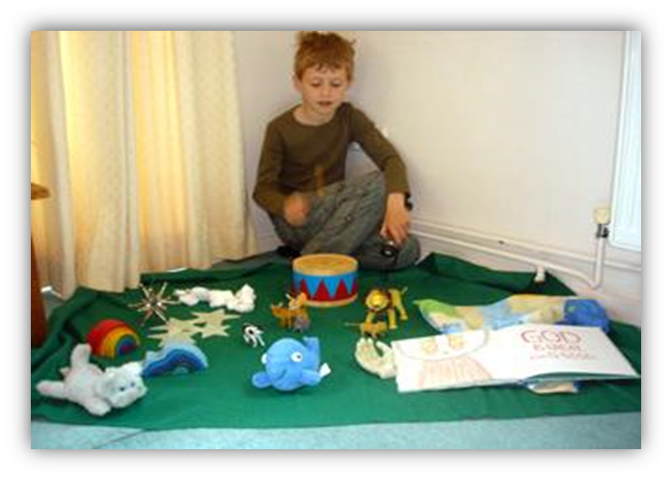

Slide 14
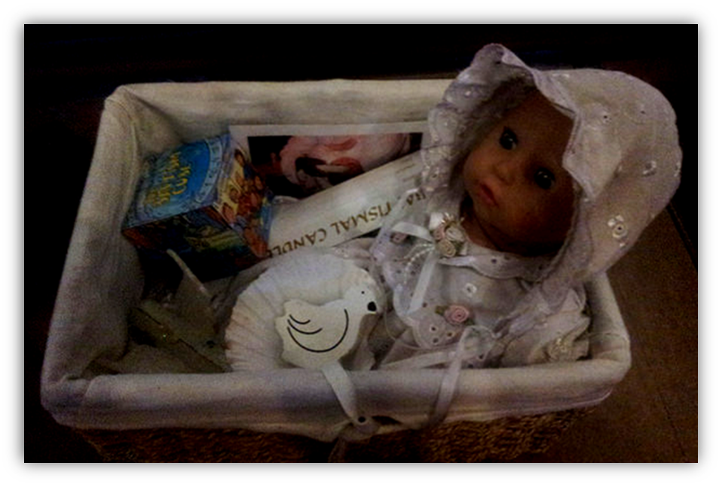
Liturgy

Slide 15
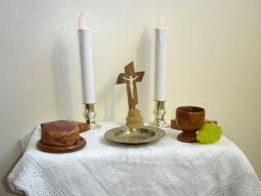
Photos: Victoria Goodman, Spiritual Child Network
http://www.spiritualchild.co.uk/cahsacredspace.html
Note how nothing is breakable or flammable!

Slide 16
Photos: Victoria Goodman, Spiritual Child Network
http://www.spiritualchild.co.uk/cahsacredspace.html

Slide 17
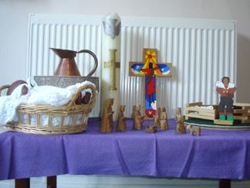

Slide 18
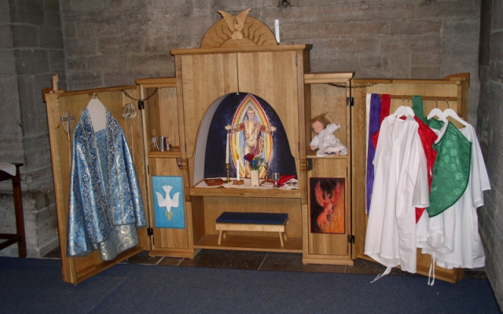
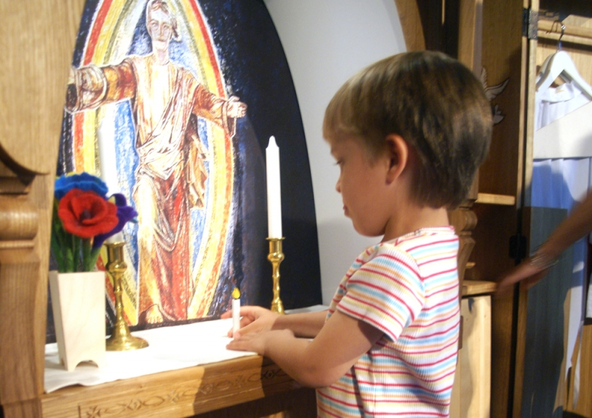
http://linkopingsdomkyrka.se/barnens-altarskap

Slide 19
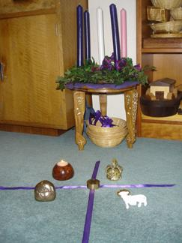
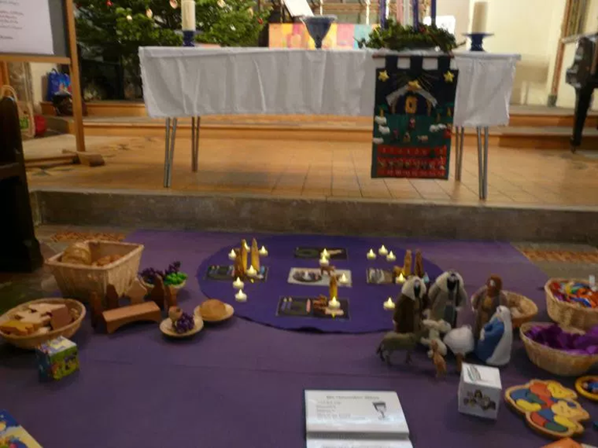

Season
http://www.spiritualchild.co.uk/cahresponse.html

Slide 20
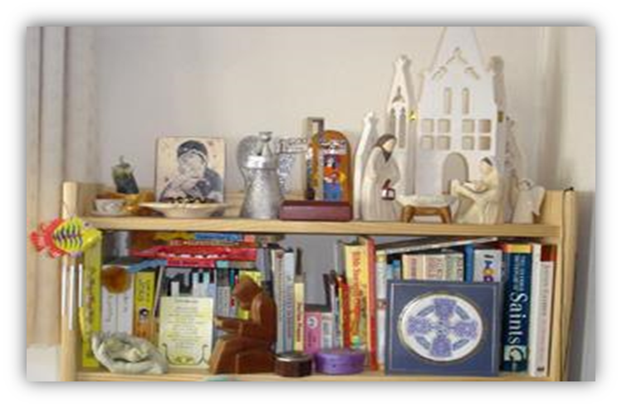


Slide 21
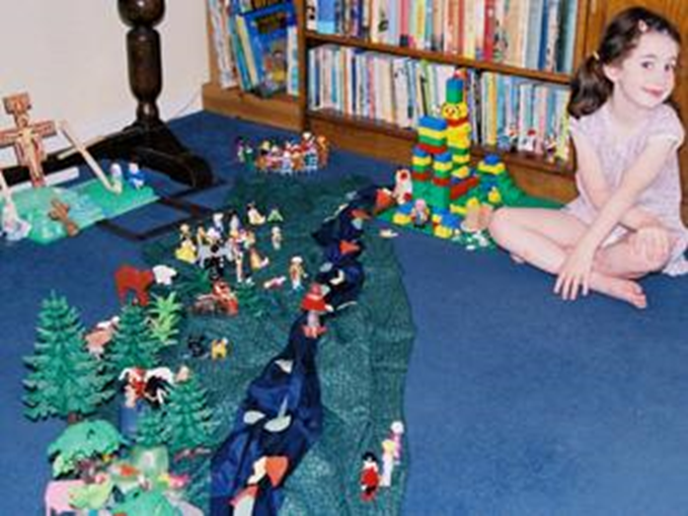
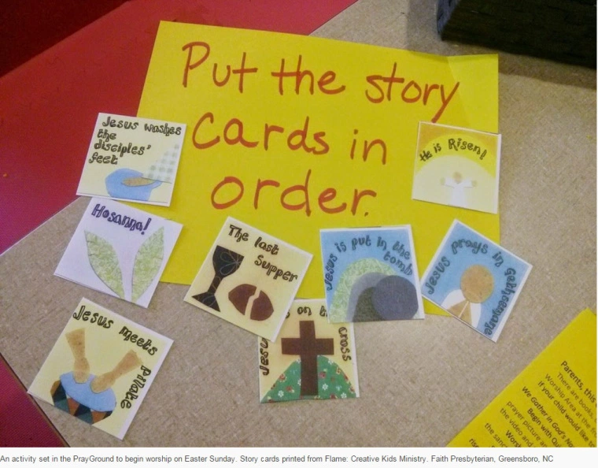

Slide 22
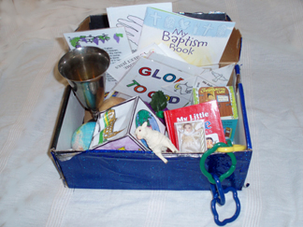
Liturgy Boxes
http://spiritualchild.co.uk/liturgyboxes.html
Gathering
Prayer
Story
Flags
Cubes
Egg cups/toy bread
Lamb
Tips for parents

Slide 23
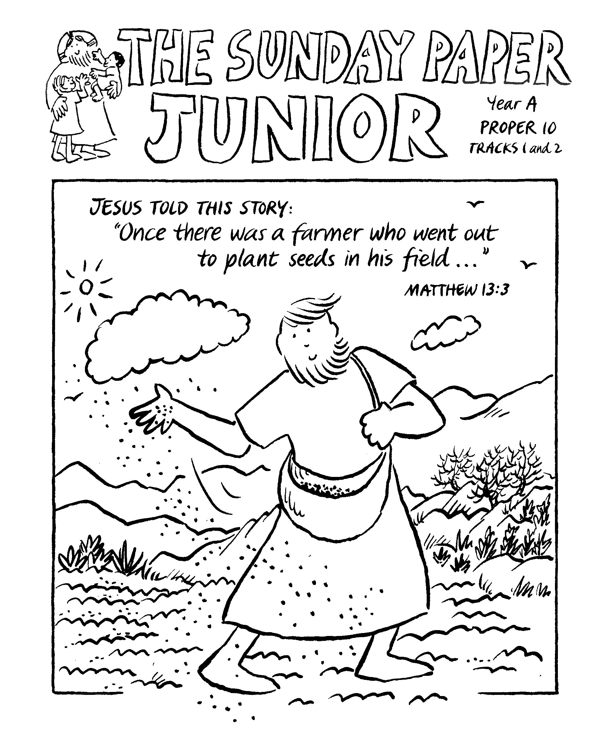
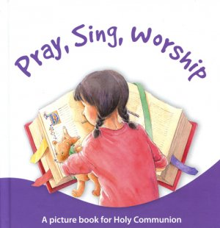
Into KS1 …
Blank paper – “Pew Art” can be highly spiritually nourishing
A word search/crossword/etc: http://puzzlemaker.discoveryeducation.com/
A Treasure Hunt with images of items in your church
http://www.the-sunday-paper.com/index.html

Slide 24
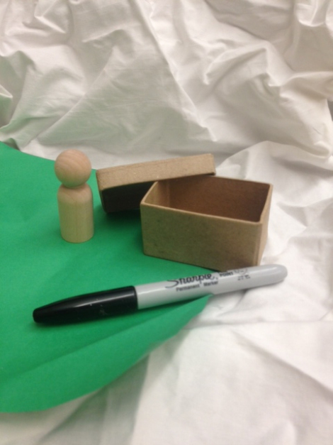
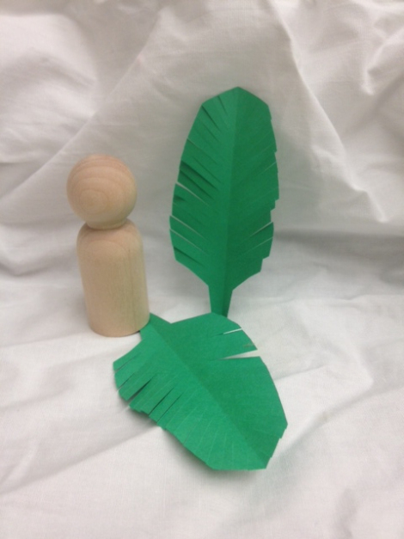
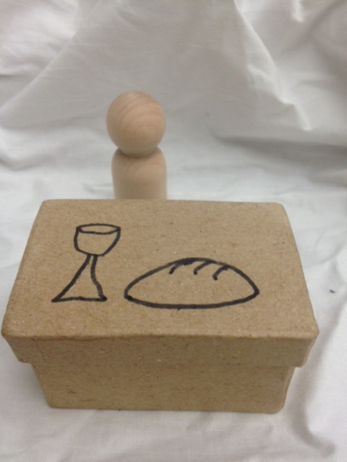
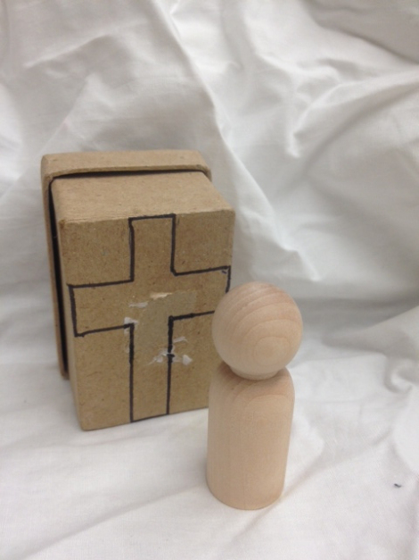
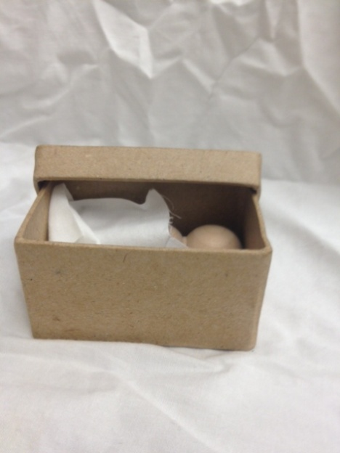
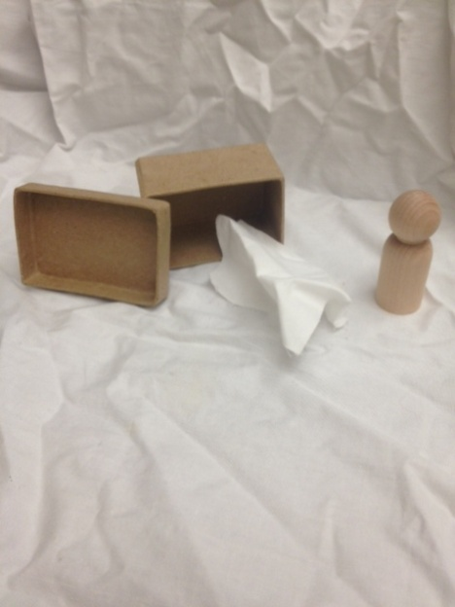

Linking Church and Home
https://camillelebronpowell.wordpress.com/2013/03/18/
holy-week-box/

Slide 25
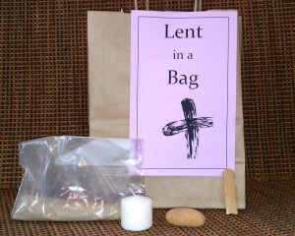

Lent in a Bag
Sand, rock, candle, human figure.
Reflections included for each item.
Suggestions for how to use the items and reflections.
http://www.buildfaith.org/2013/02/08/lent-in-a-bag/

Slide 26
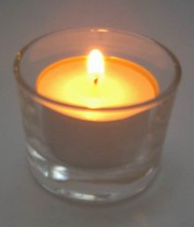

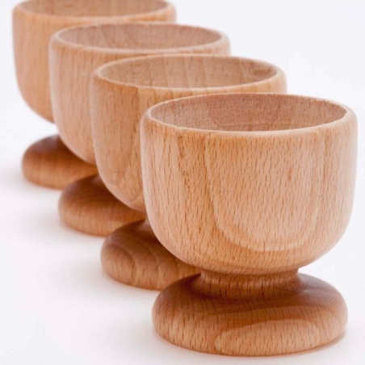
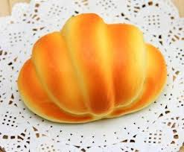

Sacred Space Starter Kits
A candle or tealight (electric is preferable with littles)
A stress ball with a globe pattern (hold it while you offer prayers for the world)
A wooden egg cup and piece of toy bread

Slide 27
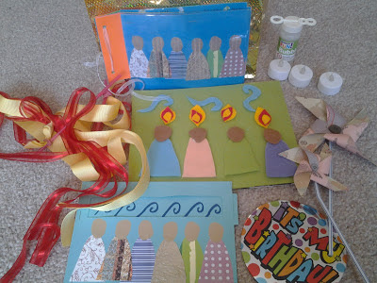
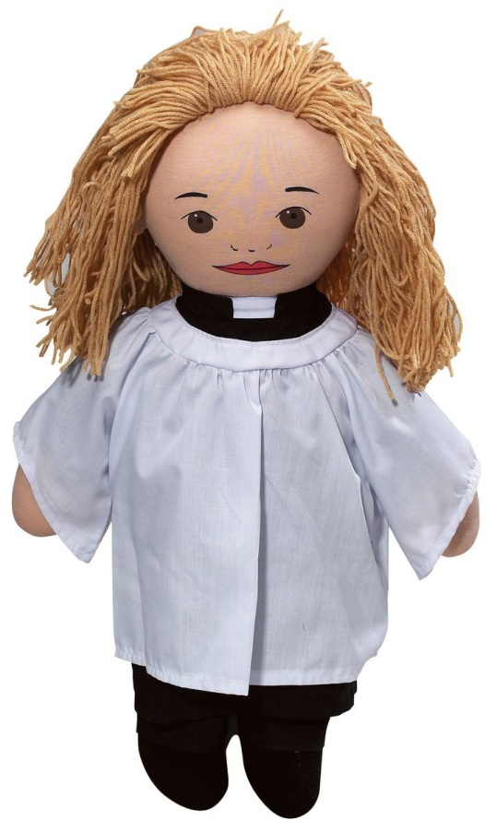
Lending library
Story bags/baskets
Prayer bags (see http://flamecreativekids.blogspot.co.uk/search?q=prayer)
Worship-based toys (priest doll, chalice and paten, toy church, etc.)
Photos: top – Flame Creative Kids, bottom – Articles of Faith

Slide 28
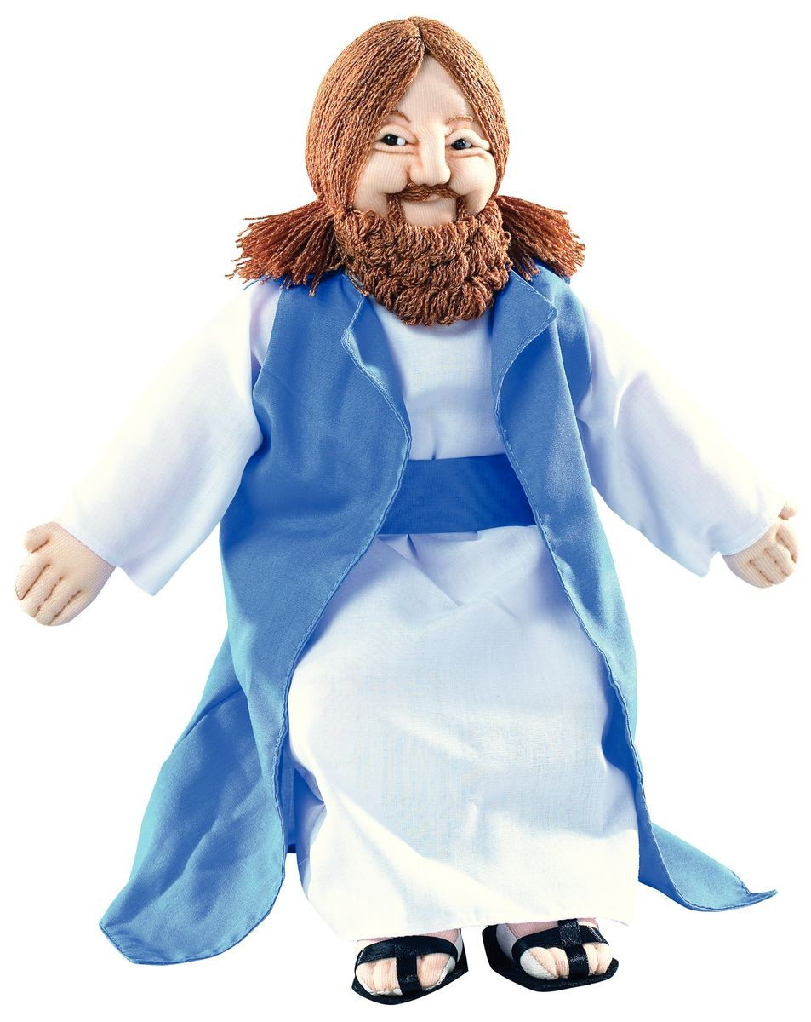

Jesus Doll
Send the Jesus Doll home with a different child each week (£14 from Articles of Faith)
Requires fairly steady attendance, unless you’re willing to do it as an occasional thing – whenever he comes back, he goes out again.
Could also work with a shepherd toy, a sheep puppet, etc. Not as easy to do with an artefact, e.g. a cross – not as much potential for PLAY.

Slide 29
Buy special items new
Articles of Faith (http://www.articlesoffaith.co.uk/)
Mustard Seed Kids (this is me, so, conflict of interest alert) (http://mustardseedkids.co.uk)
Many cathedral bookshops
Pauline Books and Media (http://www.pauline-uk.org/)
Playmobil (toy church, Egypt sets, Rome sets, Christmas stable, shepherd and sheep, Noah’s ark, etc.)

Slide 30
Resources
http://stalbanscme.com (also search Facebook for “Children’s Ministry St Albans Diocese”)
http://www.prayerspacesinschools.com/
http://flamecreativekids.blogspot.co.uk
http://www.faithinhomes.org.uk/
https://uk.pinterest.com/margaret_pritch/
https://uk.pinterest.com/revmaryhawes/
http://www.spiritualchild.co.uk/home1.html (also search Facebook for Spiritual Child Network – the group, not the page.)
http://www.buildfaith.org/

