Slide 1

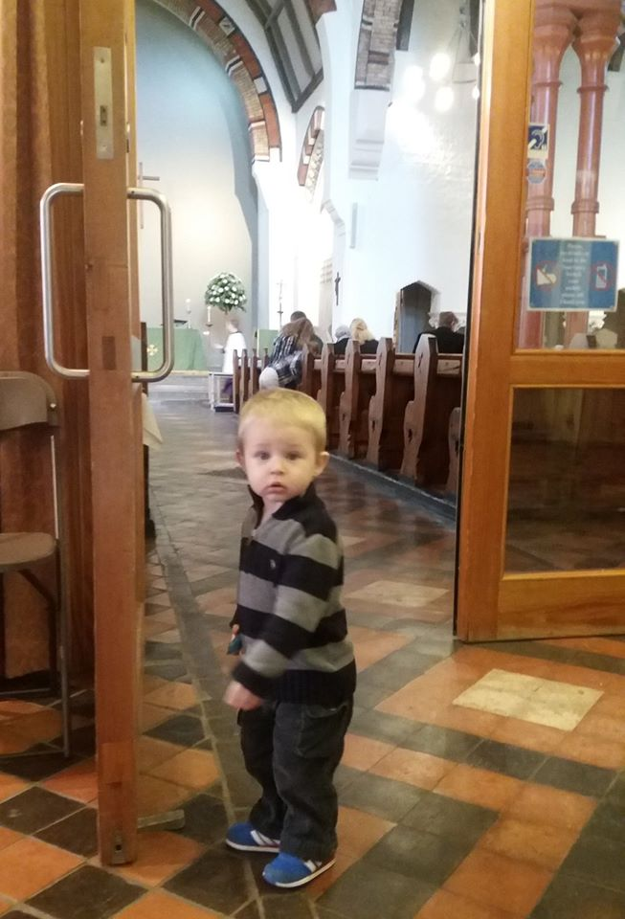
What are the contexts in which we are likely to be doing pastoral care of children and young people?
cme@stalbans.anglican.org Twitter: @stalbanscme Phone: 01727 818 176 Blog: stalbanscme.com

Slide 2
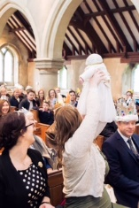
Infants: Who can I trust?
Bonding and attachment
Trust in the world/people
“Am I safe?”

Slide 3
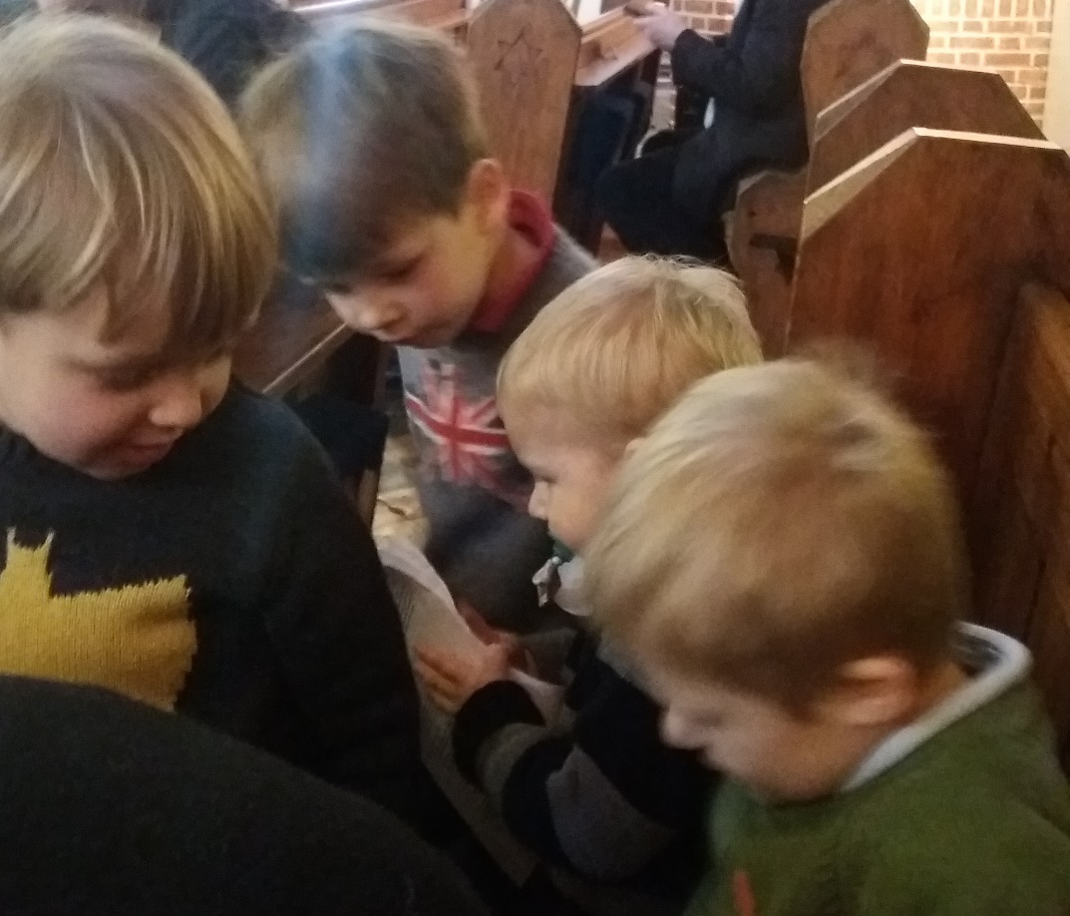
Toddlers/Preschoolers: WHY?
Independence/exploration
Social skills – awareness of “other”
Self-control/delayed gratification

Slide 4
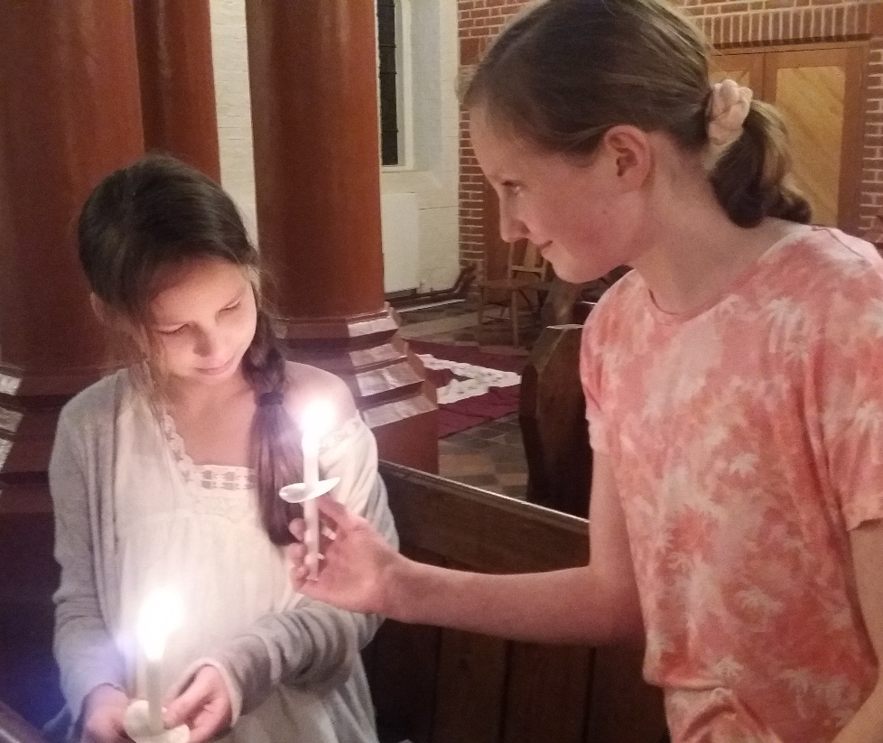
Primary school: What can I do?
Defining skills and interests
Imaginative play and profound emotional connection to characters
Move from black and white/literal thinking to fluid/abstract
Language and problem-solving start to outweigh tantrums
Gradual move → parental/caregiver approval overtaken by peer group approval
Beginning to challenge authority

Slide 5

So that’s a “normal” child …
What are some of the things that can go wrong in a child’s life?
How do children show that something isn’t right?

Slide 6
New school
Domestic violence
New baby
Substance abuse
Bereavement
Moving house
Bullying
Parental unemployment
Abuse
Neglect
Foster care
Eating disorders
Self-harm
Regression
Anxiety
Anger
Withdrawal
Inappropriately sexual behaviour
Mood swings
Fears of separation/clinginess
Embarrassed to take friends home
Easily upset by disagreement/noise
Lots of questions
Taking on inappropriate responsibilities
Hypervigilance
Extremely self-critical/perfectionist
Shame

Slide 7
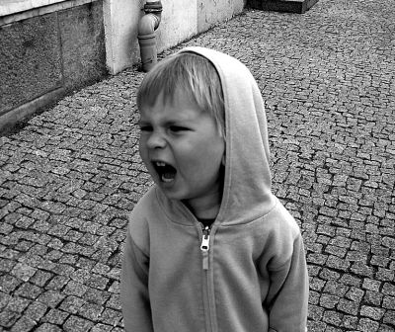
“Children have a limited ability to put feelings, thoughts and memories into words and tend to “act out” with behaviours rather than express themselves verbally.”
- Child Bereavement UK

Slide 8
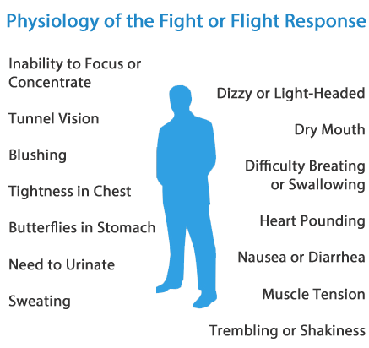
“Prolonged periods of stress [may mean that] children … lack self-regulation strategies, resorting to “fight or flight” responses in the face of perceived threat. They may be more likely to react to stimuli which are perceived as non-threatening to others, and it can be difficult to understand what these triggers are when we don’t know the child well.”
- Headteacher Update magazine
(Typo not mine!)

Slide 9
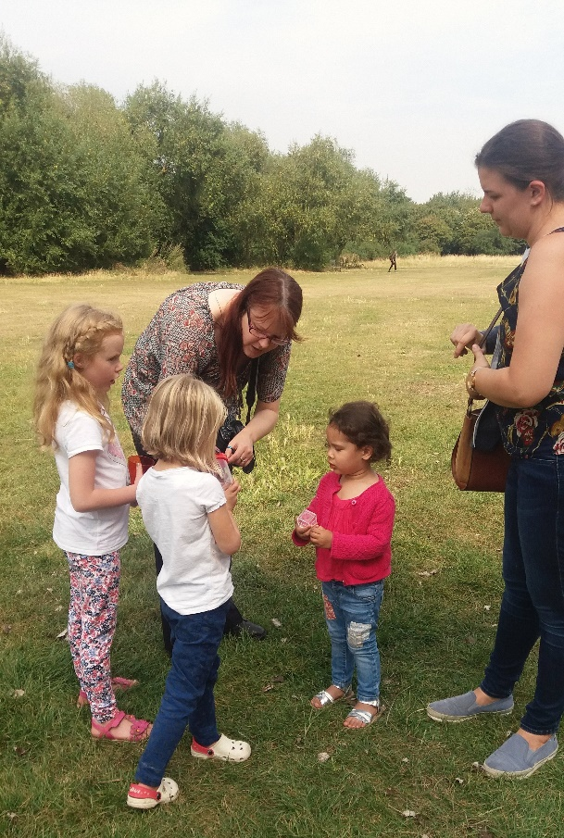
Stability:
Clear expectations for behaviour.
Routines – explained, departures from them pre-warned.
Rewards and (loving) consequences that make sense.
Cooperation and helpfulness noticed and praised.
Positive discipline – the behaviour, not the person.
Enough and more than enough …

Slide 10
3 Cs:
CATCH: Catch one of the worried thoughts.
COLLECT EVIDENCE: For/against
CHALLENGE: Challenge the fear by creating a new, more balanced thought.
Jacob is terrified of needles. He needs some dental work and will have to get 10 injections next week.
CATCH: I cannot handle these injections
COLLECT EVIDENCE:
Evidence for ------------- Evidence against
I’ve never had 10 in a row I’ve coped with past ones
The mouth is sensitive I handled a broken arm
I kinda freak out under stress I’ll have a sedative
I’m older now than the last time
CHALLENGE: Although I can be sensitive to needles and no one likes getting shots, I’m older since the last dental work I had and I’ll have a sedative to help. Plus, it’ll be over in an hour! I can handle an hour!

Slide 11
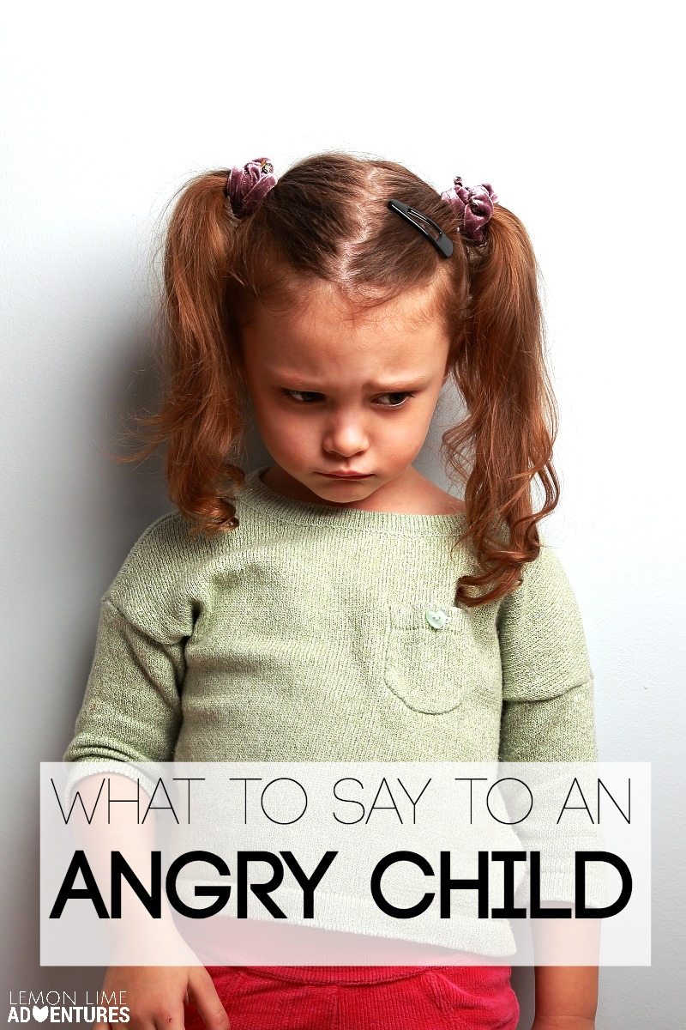
I love you. (depending on relationship – otherwise other affirming words.)
I see that you are upset. It is okay to be angry.
Would you like my help/a hug/something to eat/to play with the Lego?
I am going to…

Slide 12

The healing power of story:
“My daddy’s in jail” – how the story of Joseph got kids talking.
“Like my brothers!” – the story of Ruth and family trees
Worship and children’s activities are key places for pastoral care.

Slide 13

Prayer time as pastoral care:
Quiet time
Meditative
Deep breathing
A time to share concerns in a safe space (establish ground rules)

Slide 14
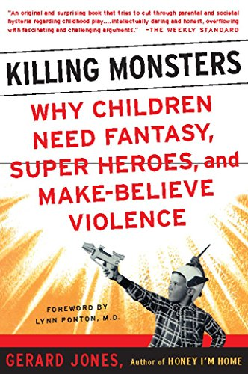
Fantasy and play: powerlessness and resilience
Excerpt from “Killing Monsters: why children need fantasy, super-heroes, and make-believe violence,” by Gerard Jones

Slide 15
“Christians, of all people, should be able to admit that yes, there most certainly are monsters under the bed. You are not imagining them. The world is a scary place. Our life is not merely a journey in which we may sometimes get tired or lost or discouraged; it is a dangerous venture through a war zone, in which we may be attacked, ambushed, or tempted to join the Enemy’s side; in which we may be assigned to missions calling for all the courage and intelligence we can muster.
And in that cosmic battle, we have by our side the unlikely superhero from Nazareth, the meek-and-mild carpenter who proved to be stronger than sin, stronger than death; who by his courage and loyalty has faced and defeated the Enemy, and who invites us, and empowers us, to follow him through the darkness to the final victory, with the saints who ‘nobly fought of old’.”
- Gretchen Wolff Pritchard

Slide 16
Rules of Thumb:
Behavioural change is a sign that something is wrong
Unconditional positive regard
Praise and reassurance of love
Parents and clergy: key points for hearing of pastoral concerns
Tailor group activities appropriately
Don’t be afraid of questions
Tell stories honestly – don’t point to a moral or take out the scary bits (but do use your judgement)
Allow room for free response through art, play, and fantasy
Provide books/journals to take home, etc.
Respect privacy but don’t promise to keep secrets
Refer when needed

