Slide 1
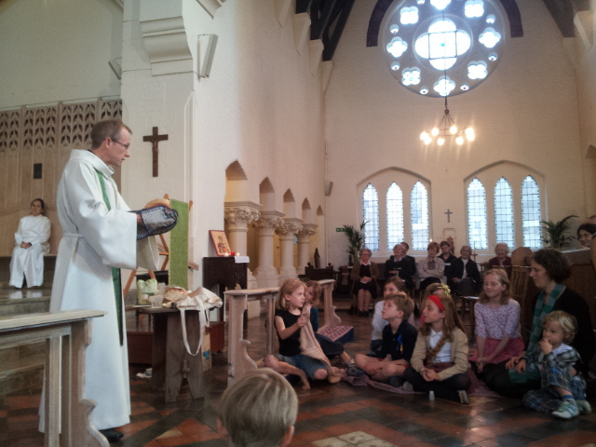
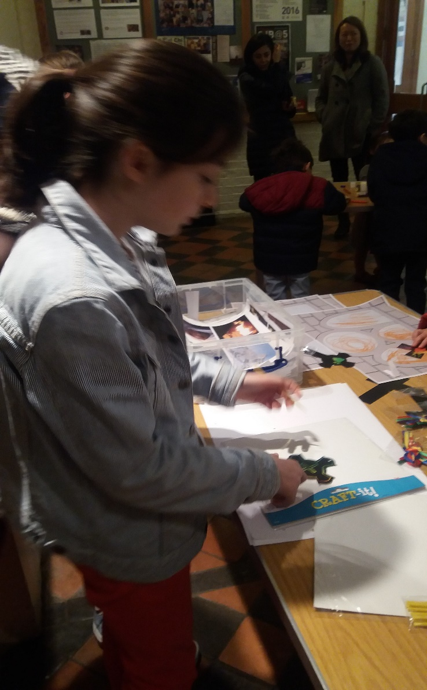
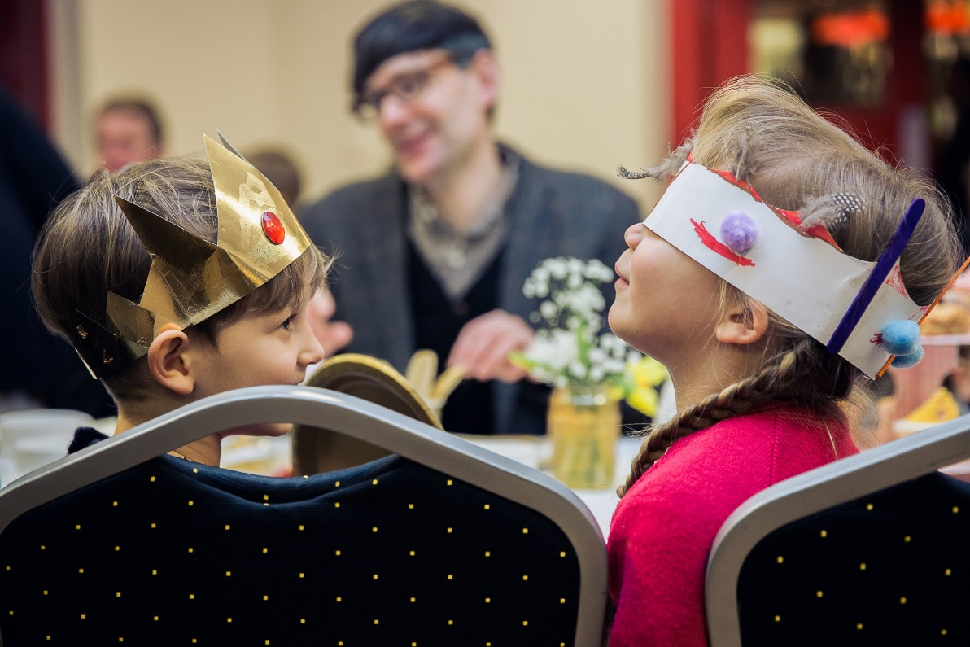

Getting
Started

Slide 2
“Growth is found where there is a high ratio of children to adults. Churches which offer programmes for children and teenagers are more likely to grow.”
From Anecdote to Evidence © 2014 The Church Commissioners for England www.churchgrowthresearch.org.uk

Slide 3
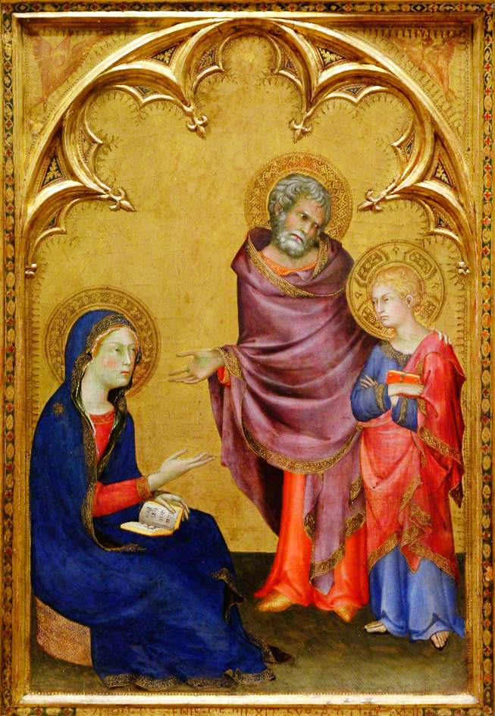
Are there children living in your street? How many, what ages?
Are there grandparents in your congregation? Godparents?
When was the last time you used Back to Church Sunday?
Is there a school in your community? What sort and for what age group? Is it a Church School or not?
Do you have contact with the school? Who and how?
Is there a nursery school or playgroup? Do you have contact with them?
Is there a Children’s Centre? What contact do you have?
Is there a medical centre? What does it provide for children?
Do you have contact with the Health Visitor / Midwives?
Is there a local recreation ground? What is it like?
Are these facilities used by children?
Are there any sports groups/playing fields?

Slide 4
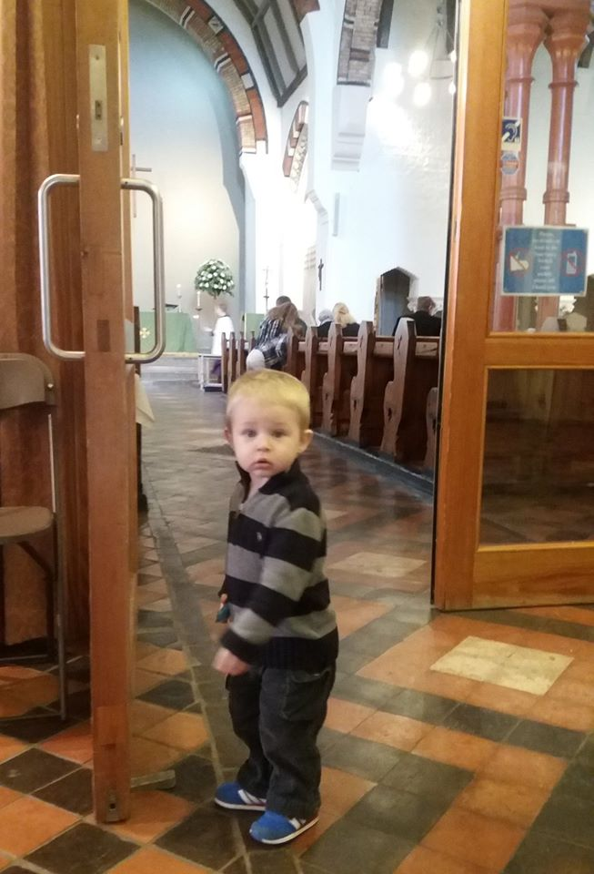
Challenges
“I’m so sorry – we have rugby on Sunday mornings.”
Blended families and geographical spread – joint custody (weekends in different places), grandparents far away, etc.
Tiny village with few families
Occasional is the new regular.
Church culture
Church space
Suspicion of organised religion

Slide 5
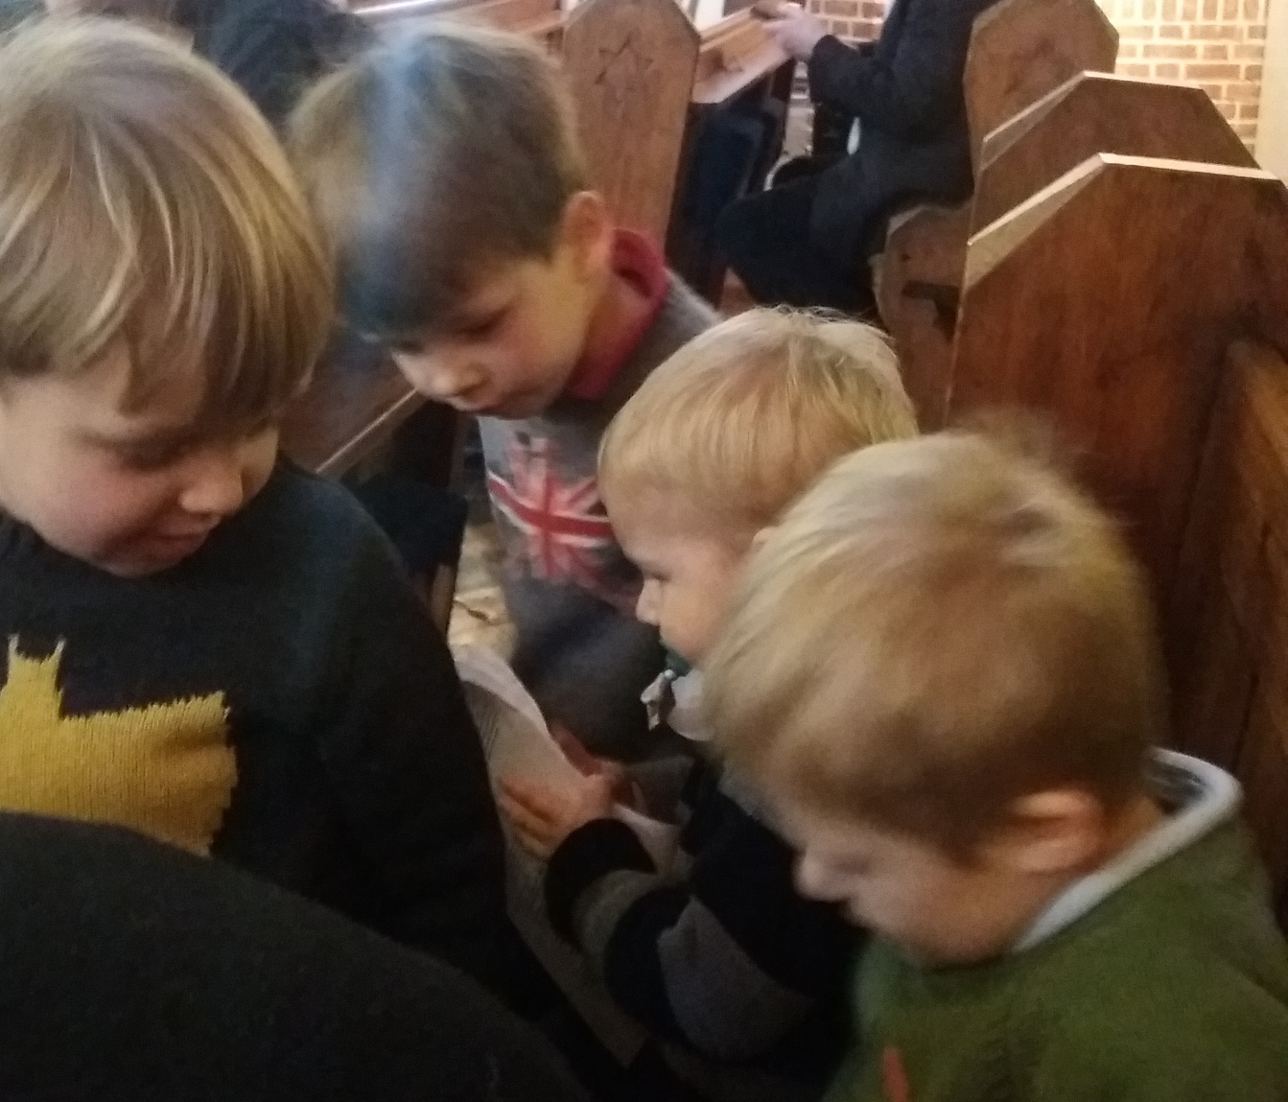
Most common opportunities:
Programmes outside of Sunday mornings
Baptisms
Addressing welcome (culture and space)
Contact with schools
Photo: the William and George story … children’s ministry is fluid.

Slide 6
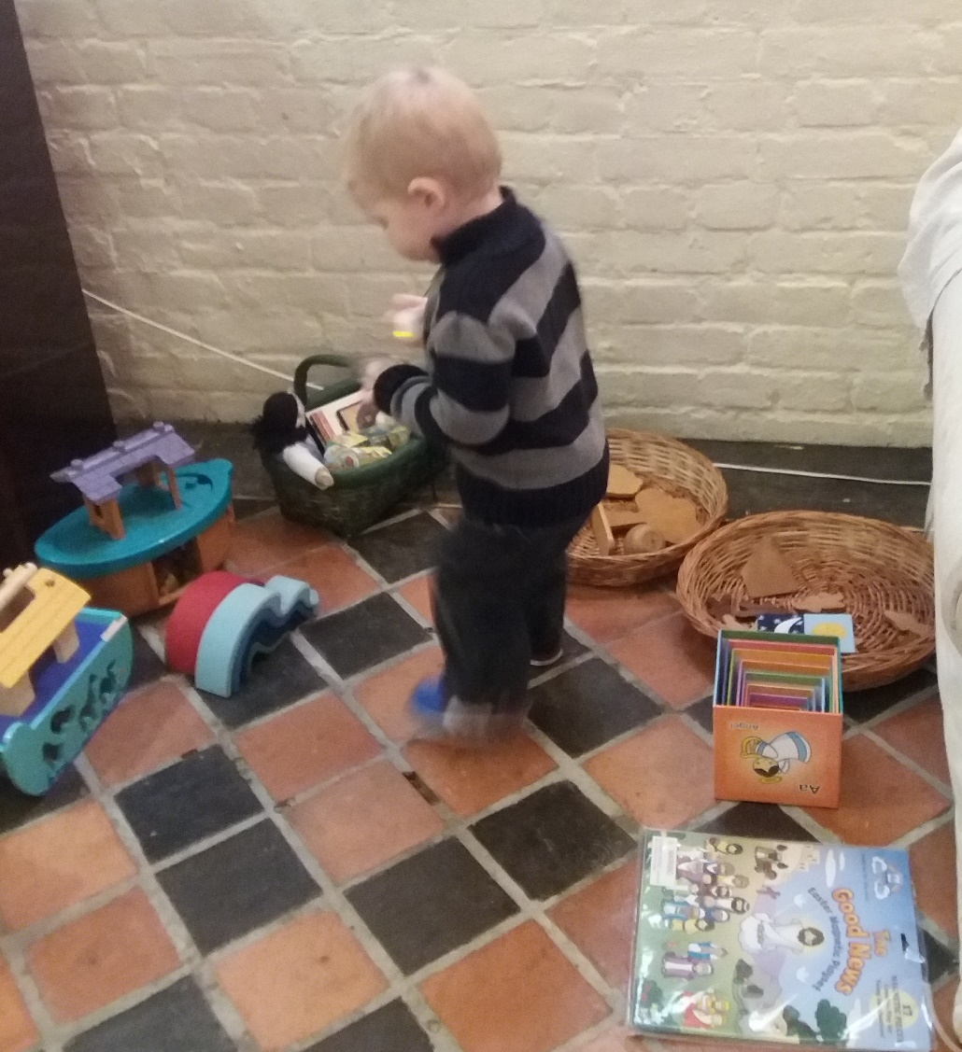
Outside of Sunday morning (mission):
Messy Church
Lunchtime or afterschool clubs
Toddler praise
Prayer presence at sporting events
Family services scheduled around local sports groups
Holiday clubs
Choirs or other specialist activities – what are your church’s talents?

Slide 7
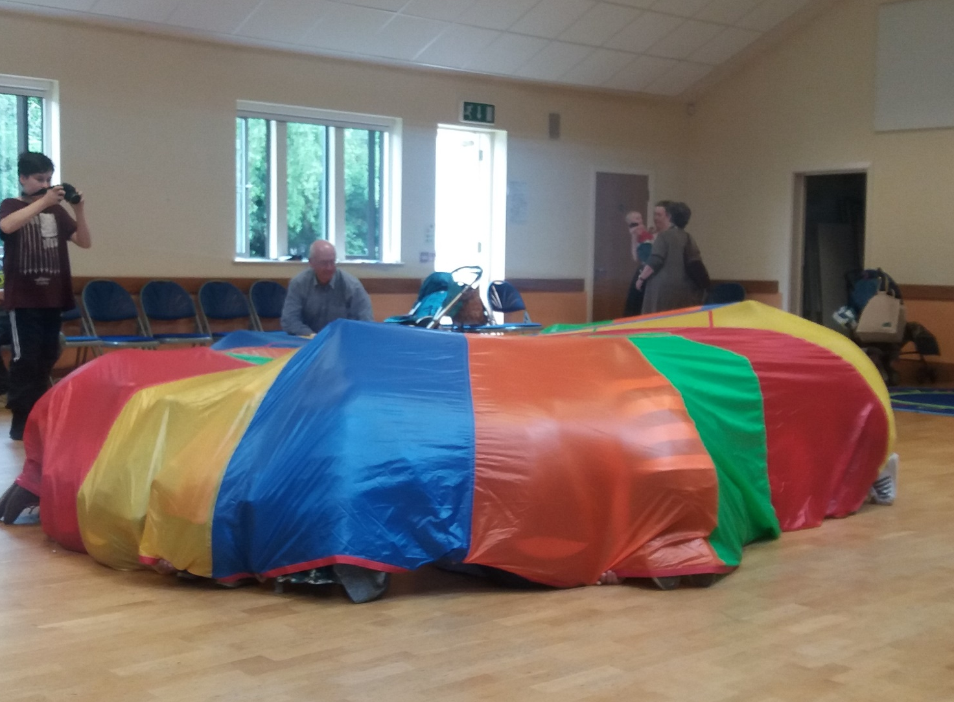
Outside of Sunday morning – non-worship focused (ministry to):
Café
Soft play centre
Community events
Homework help clubs
Other secular after-school activities
Do you have a local Foodbank? Story time and free book for families.
Connect with other charities in your area.

Slide 8
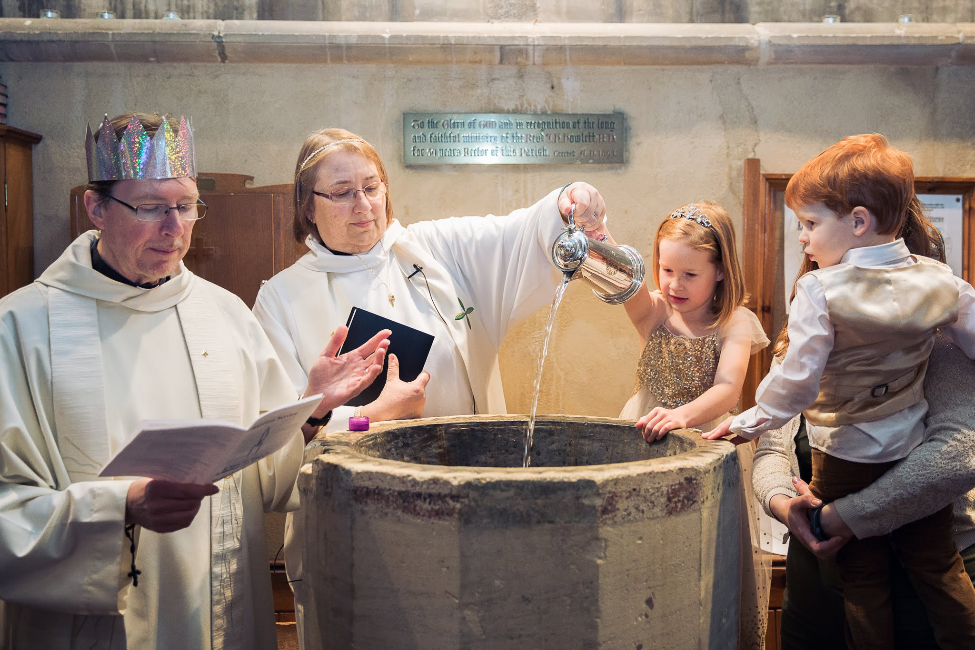
Baptisms
23rd May – Baptism Matters follow-up event, venue TBC
Preparation is key: meeting people other than the vicar and attending a service.
Importance of Godparents
The service itself – warmth and welcome matter more than the exact wording/liturgy.
Follow-up – the Debenhams lesson

Slide 9
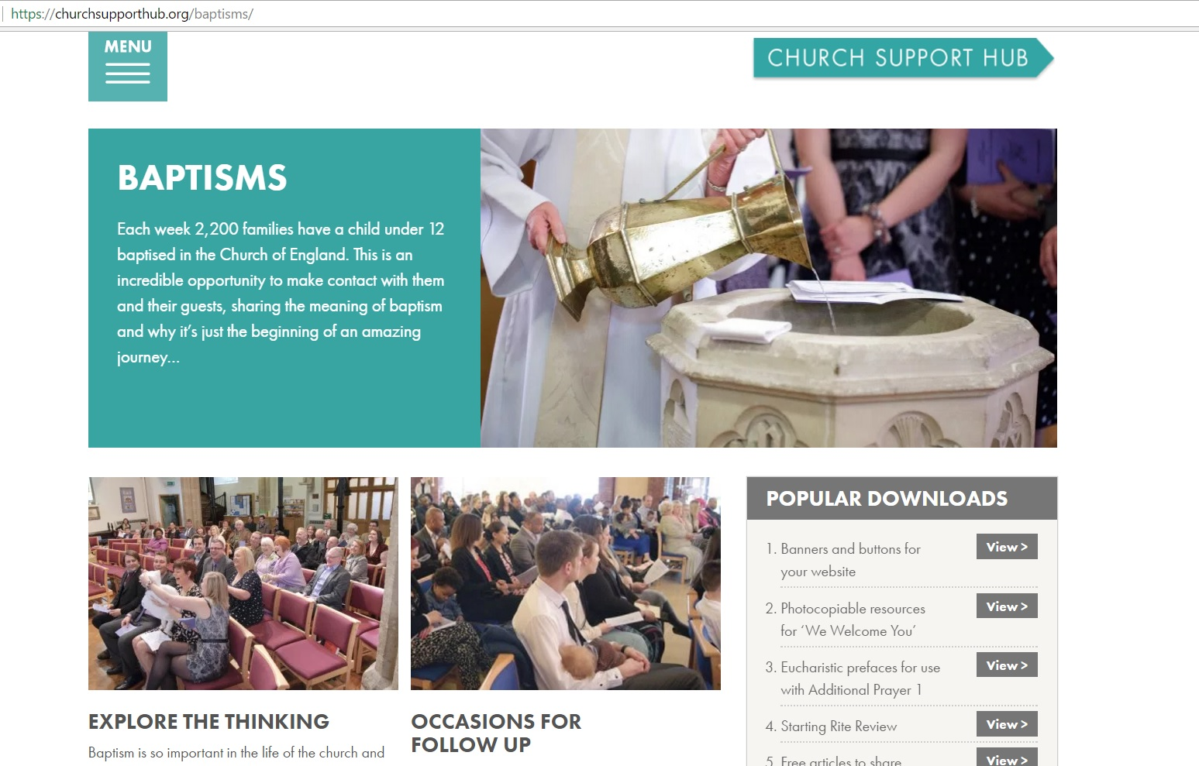

Slide 10
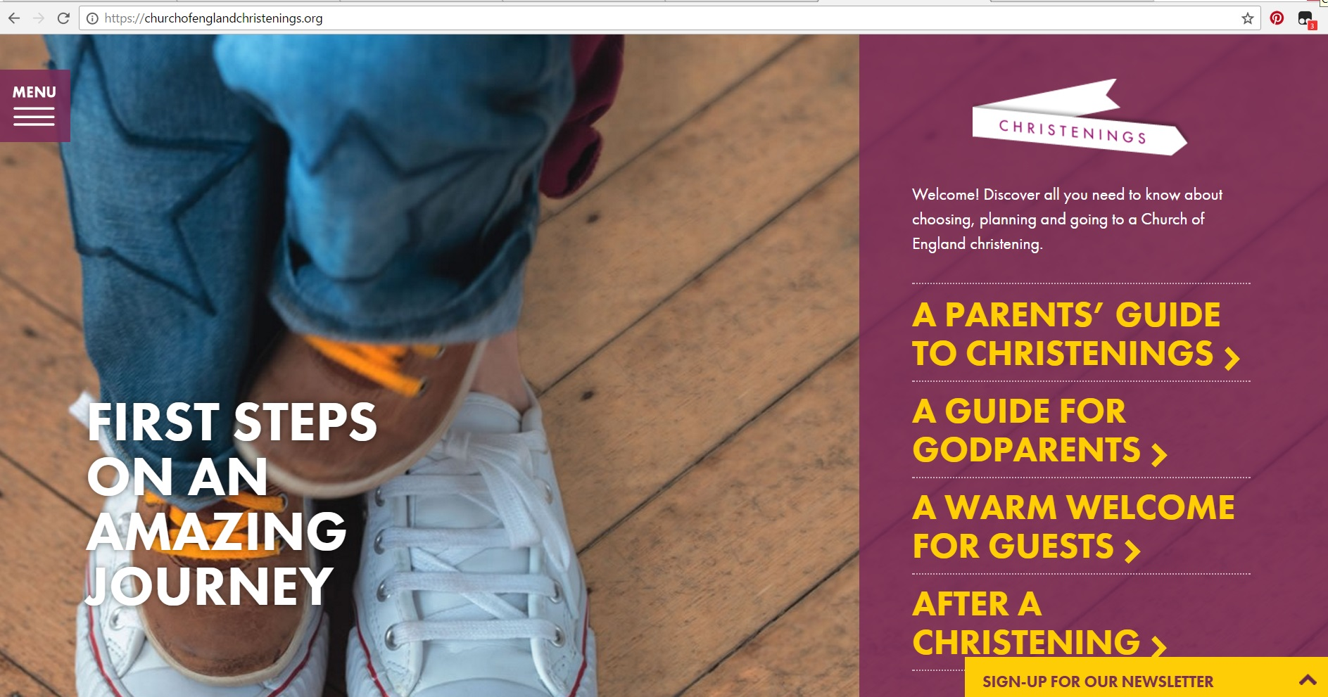

Slide 11

Addressing Welcome

Slide 12
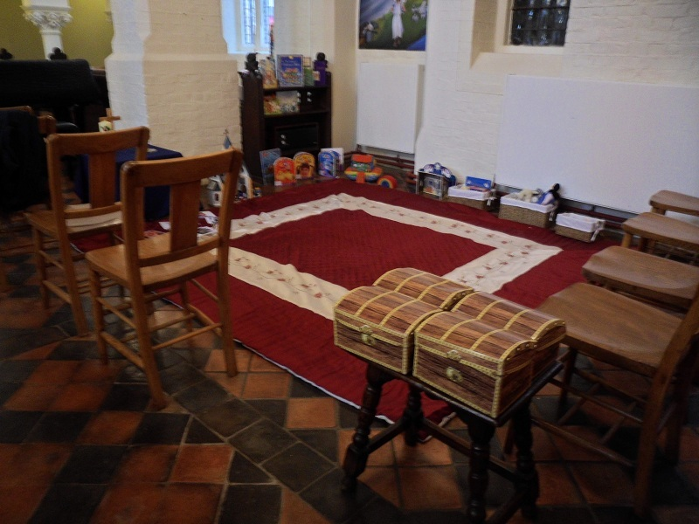
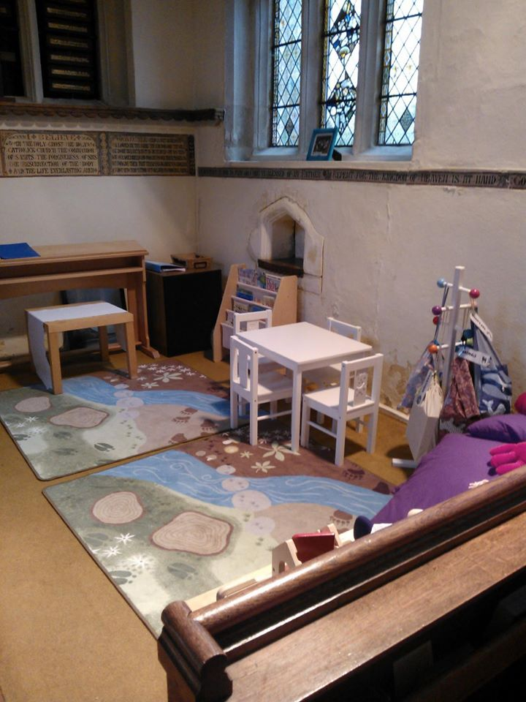
Children’s Corners/Pew Bags
Is the front of the church visible?
Are the toys related to Christian story/liturgy/seasons?
Is it somewhere newcomers/visitors won’t feel exposed?
What age(s) is it for?
Lots of ideas and resources available on our leaflet!

Slide 13
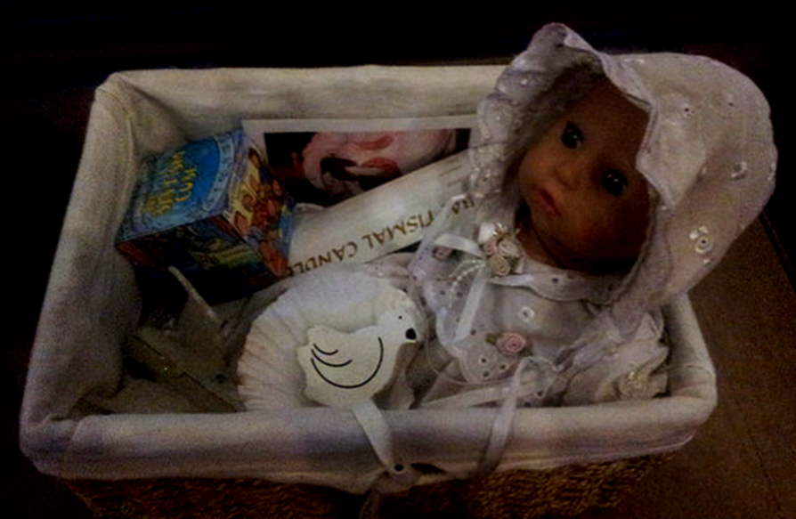
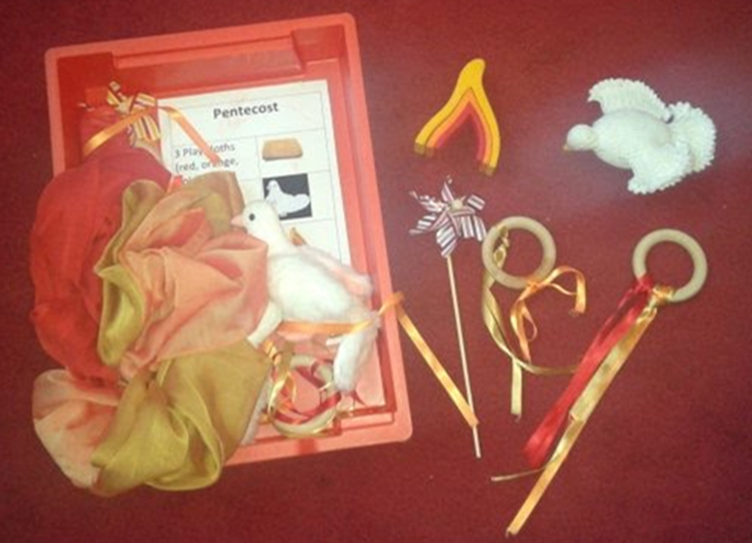
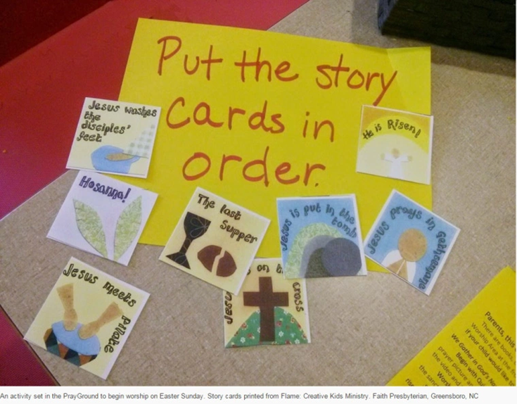

Slide 14
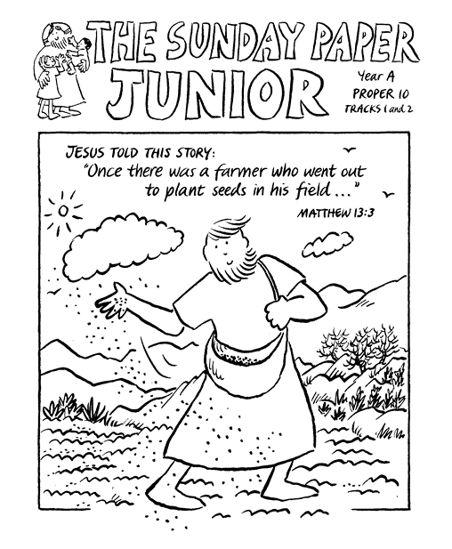

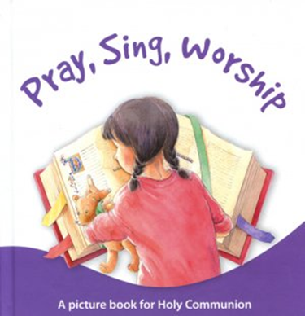
Older children:

Slide 15
“If we are going to change in order to attract the unchurched … we have to make sure that somehow or other the unchurched find out that we are doing it, otherwise what will likely happen is that we will upset and offend the current membership in the interest of appealing to entirely hypothetical newcomers who have not in fact ever thought of entering our doors.
“Happened at my previous church. Music director replaced traditional music with upbeat pop to appeal to the world at large. The world at large never showed up, and many of the long-time members were deeply, deeply upset by the changes.
“Since I left (and both the vicar and music director also turned over) they have switched the music again, to a jazz mass on Sunday mornings, and the place is growing again. The difference: BIG VINYL BANNERS HUNG ON THE FRONT FENCE, advertising the jazz mass. Also, the jazz is well done, by excellent musicians.”

Slide 16
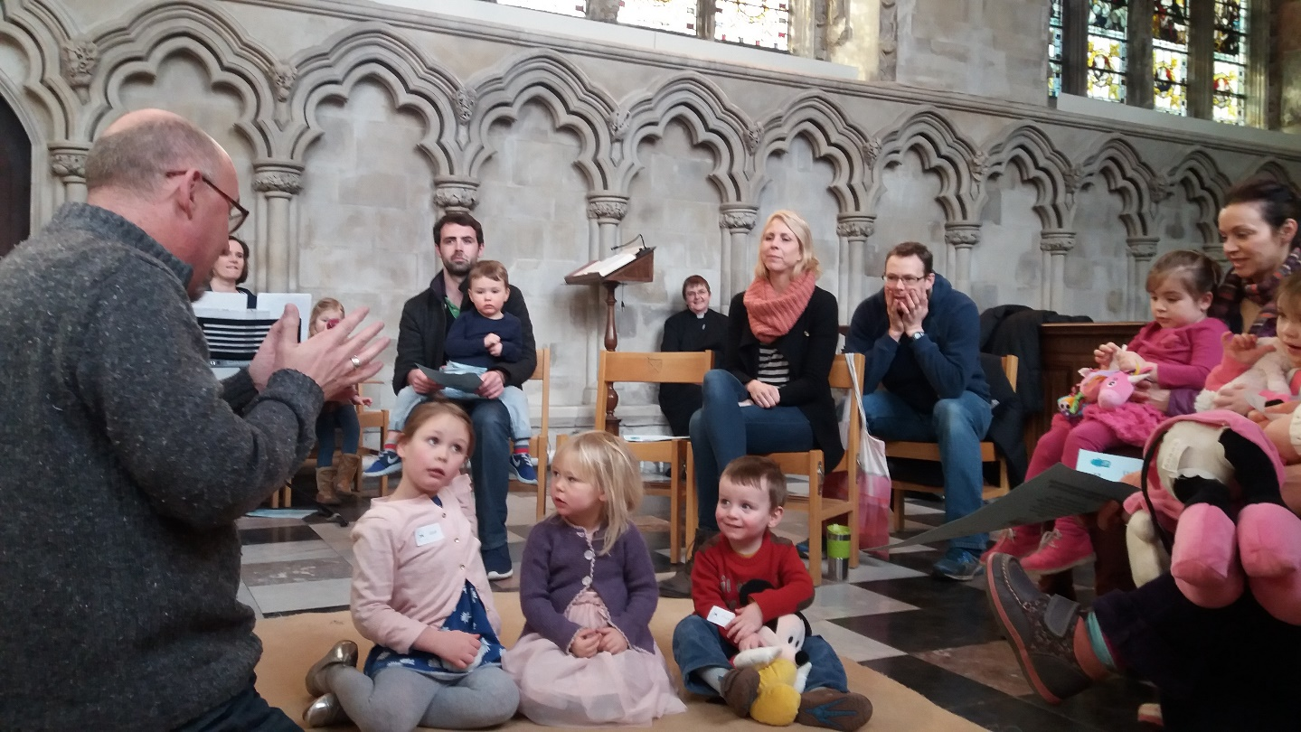
“Ssssshhhhhh!”
“Sound” vs. “noise.” Children do need to be taken out when having tantrums, screaming, etc., but not for the normal sounds of children being children, and ESPECIALLY not for sounds that show active engagement in worship, e.g. “Look at the candles! Pretty! Amen!” (verbatim quote from a 2-year-old in my church a few months ago, which got shushed by an adult worshiper nearby.)
Usual reasons for people being upset with the presence of children in church:
  Pastoral reasons
  Fear

Slide 17


Slide 18
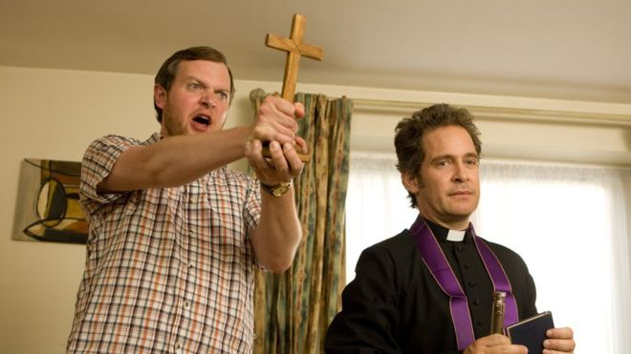
What went wrong there?

Slide 19

Change (where Adam messed up):
Passive-aggressive
Territorial and defensive – not open to new ideas, not willing to share power
Immediately leaps to seeing problems

Slide 20
Change (where Darren messed up):
Within your existing tradition
With benefits to the existing community – connections made clear
With allies and accompaniers
With authenticity – matters more than perceived coolness.
With compromise where possible, and conviction where needed.

Slide 21
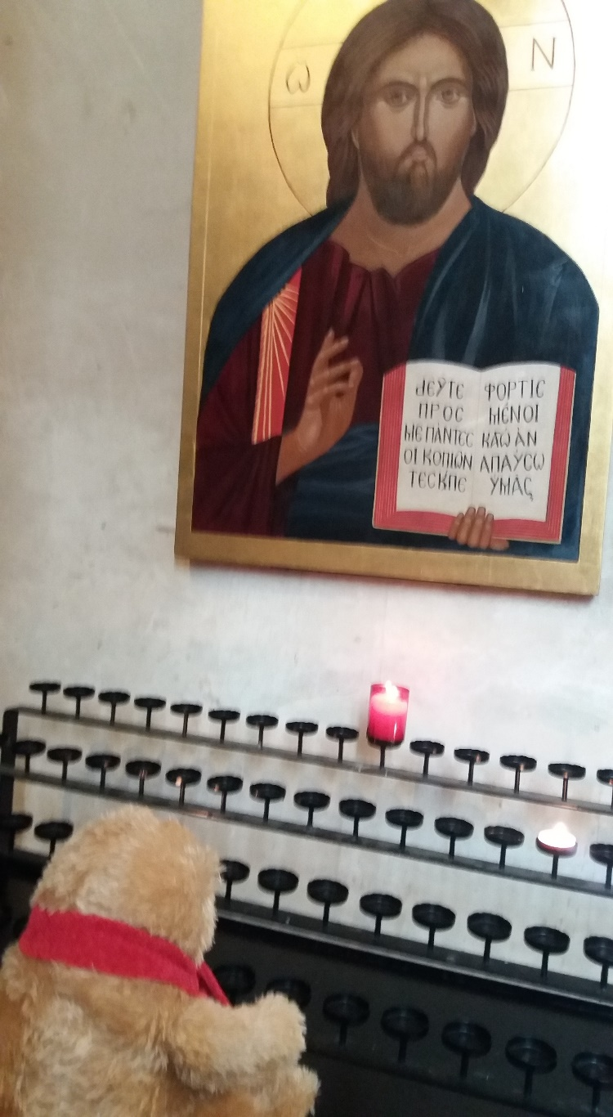
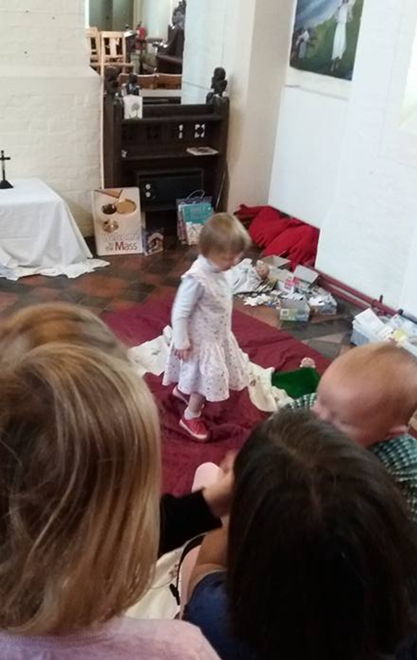
Why the double standard?
Perception that children are ‘guests’ at an ‘adult’ event.
Gretchen Wolff Pritchard
Crucially, this is internalised by PARENTS as well as other worshippers.

Slide 22
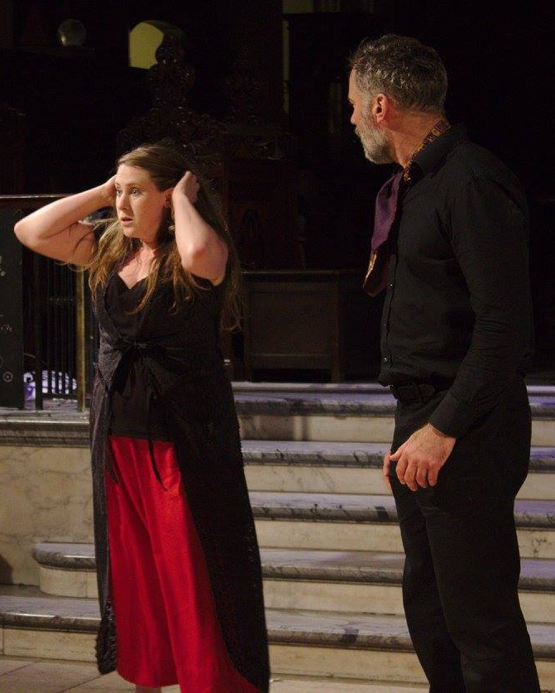
How this assumption affects everyone:
Story: Rehearsal is different
from a birthday party!
Adult worshippers – “children are disrupting an event that’s for me.” They may be more accepting at family events or other occasions where they understand it’s for everyone.
Parents – “my children are misbehaving and bothering the people who this is for. I’m embarrassed and I need to make them behave.” Emphasis on not disturbing others, rather than engaging in the event. Watch these same parents at a children’s puppet show – they behave differently.
Children – “this is not for me. I have to sit down and shut up instead of being actively engaged.”

Slide 23
Helping Parents and Other Adult Worshippers
The question was put on the Spiritual Child Network’s Facebook page: “how do people answer complaints about young people making any noise in church?”
Here are a few of the replies …
I usually say," It is good to know that a few people are alert and participating!" However, on a serious note, I try to engage the children with a specific task during the quieter moments of the service. And if they are young we also encourage others to share the care of the child so that the parents can worship. We have sought a few people to do cuddle duty on a Sunday morning. Seems to work and everyone is more relaxed. Reminding the more grumpy ones that we are a family, warts, noise and all, also helps.

Slide 24
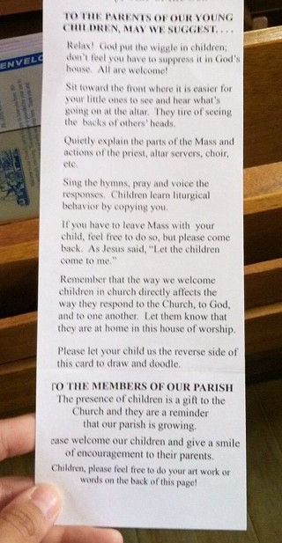
Helping Parents and Other Adult Worshippers
The question was put on the Spiritual Child Network’s Facebook page: “how do people answer complaints about young people making any noise in church?”
Here are a few of the replies …

Slide 25
The question was put on the Spiritual Child Network’s Facebook page: “how do people answer complaints about young people making any noise in church?”
Here are a few of the replies …
My son, who is on the autism spectrum, used to shout 'Boobies' over and over (we didn't know he had ASD at the time) l used to be in tears but somebody said to me that I must have the patience of a saint and encouraged me to keep coming, now I am a vicar l just zone out if kids talk (adults are often worse btw) l am just happy that they are there and would hate the parents to feel like I did before someone was kind enough to see l was struggling.

Slide 26
The question was put on the Spiritual Child Network’s Facebook page: “how do people answer complaints about young people making any noise in church?”
Here are a few of the replies …
We sat down as a PCC and talked about the place of children in worship. Having a large group of people in church who understand the aims of growing the kingdom of God means that there is someone in each area of the church who can spread the good news of Children across the whole congregation. Plus I now have a large group of people on the look out for faith based toys wherever they travel. It means that I get handed lovely things like a wooden nativity jigsaw for toddlers with "I saw this in [insert northern seaside town] and though the children could play with it".
I mean if someone tuts and says shh it's much easier for one of their peers to just say "they're OK, they're just playing" than for me to say it.
- The Revd. Robb Sutherland

Slide 27
The question was put on the Spiritual Child Network’s Facebook page: “how do people answer complaints about young people making any noise in church?”
Here are a few of the replies …
Ask the complainer if they would go on the crèche rota.

Slide 28
The question was put on the Spiritual Child Network’s Facebook page: “how do people answer complaints about young people making any noise in church?”
Here are a few of the replies …
I've learned in conversation with some of our young parents that they really don't want to be away from their children during church. Most of our young families have two working parents, and church is only on the table for them if it can also be family time. They want their kids beside them during worship, not off in a nursery somewhere. (This is also why we’re keeping Sunday school to two Sundays a month, a rhythm that is working pretty well for us.) So when the complaint is from people who raised their own kids 40 or 50 years ago, & want to know why today's kids aren't off somewhere else like theirs were, I find that explaining that big sociological shift to two-income families and those parents' understandable desire to spend time with their kids on the weekends, is sometimes helpful.

Slide 29
The question was put on the Spiritual Child Network’s Facebook page: “how do people answer complaints about young people making any noise in church?”
Here are a few of the replies …
Perhaps we have lost sight of churches as places of 'public' worship. Public places, like marketplaces, civic squares, parks and local libraries, music festivals are naturally noisy spaces. That's what happens when people gather in community... there are some exceptions, like lectures...and elite music performances, but these are usually ticketed and exclusive. Maybe we're a bit confused about the type of event that public worship is...

Slide 30
The question was put on the Spiritual Child Network’s Facebook page: “how do people answer complaints about young people making any noise in church?”
Here are a few of the replies …
The looks I see on the faces of congregation members when children are noisy are exactly the same looks I received from whites when I went for lunch with my African American friend back in barely-post-1994-South-Africa... and the unspoken question on her face then is the same I see on the noisy toddlers ... "what did I do wrong?"
I think we should call it what it is: prejudice. Kids are second class citizens in church. Even if it is driven by displaced hurt doesn't that make the child who has experienced the shushing a voiceless victim?
- Murray Wilkinson, Children & Young People Advisor, Diocese of Canterbury

Slide 31
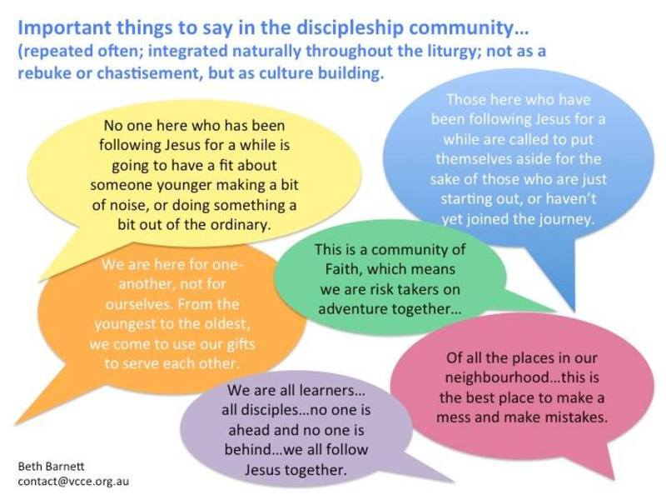

Slide 32
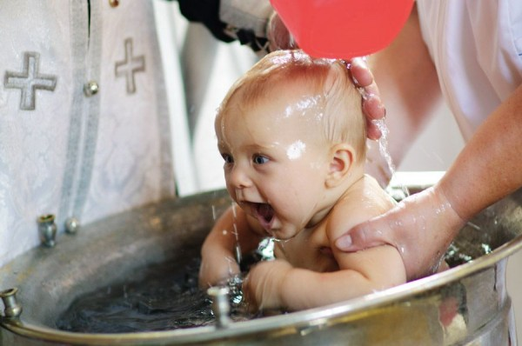
Rules of thumb:
Work with what you’ve got – your space, your people, your area, your church culture
Don’t try to do everything at once.
Focus on RELATIONSHIPS and integrity.
7 points of contact = 1 action.
Where are you? Where do you want to be? What do you need to do to get there? Stick to this.

Slide 33
Resources:
The Diocesan blog: stalbanscme.com and our Twitter account: @stalbanscme and Pinterest boards: uk.pinterest.com/margaret_pritch (includes one on Getting Started: https://uk.pinterest.com/margaret_pritch/getting-started-includes-theory-as-well-as-practic/)
To find us on Facebook, search for “Children’s Ministry St Albans Diocese”
Email me: cme@stalbans.anglican.org or email Julie (youthoffice@stalbans.anglican.org) to subscribe to our monthly newsletter.
Spiritual Child Network – the Facebook group and their website (spiritualchild.co.uk)
Godly Play: godlyplay.uk
Amy Fenton Lee (children with additional needs): theinclusivechurch.wordpress.com
Worship Workshop: worshipworkshop.org.uk
Flame Creative Kids: flamecreativekids.blogspot.co.uk
Karen Ware Jackson: karenwarejackson.com
Carolyn Carter Brown: worshipingwithchildren.blogspot.co.uk
Mustard Seed Kids (conflict of interest alert – my company): mustardseedkids.co.uk
Books:
Worship Together and Festivals Together, by Sandra Millar
There is a Season, by Margaret Pritchard Houston
Pray Sing Worship: a guide to holy communion, published by SPCK
Mission-Shaped Children, by Margaret Withers

