Slide 1

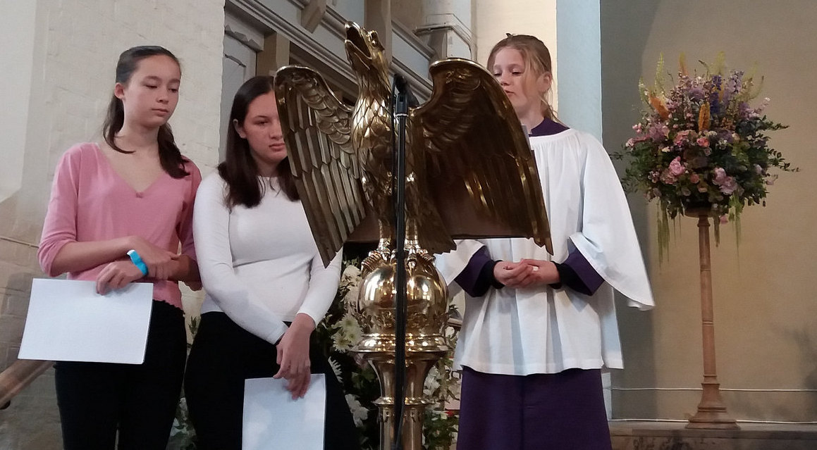
All-Age Worship Basics
Margaret Pritchard Houston
Children’s Mission Enabler, Diocese of St Albans

Slide 2
What is All-Age Worship?
What isn’t All-Age Worship?
What are some of the pitfalls in doing All-Age Worship?

Slide 3
What is All-Age Worship?
It is all-age.
It is worship.

Slide 4
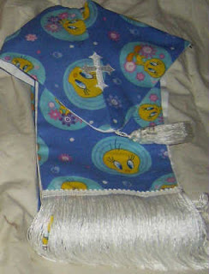
What isn’t All-Age Worship?
A children’s service
An adult service where children hold up pictures of things
A CBeebies programme
A performance (Leading worship =/= performing. How to pass on this message?)
An opportunity for children to be cute for adult approval
An opportunity to pass on a simple moral lesson
Full of babies and flowers and happiness and lovely things and nothing else. Remember the cross.
A style of worship
Tweety bird stoles are not of the Lord, and not needed for All-Age Worship.

Slide 5
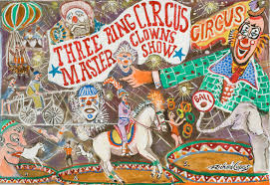
All-Age Worship is not:
You don’t need to have 18 things happening at once, one for each age group.
You are not a juggling act.
We have more in common than we realise.

Slide 6

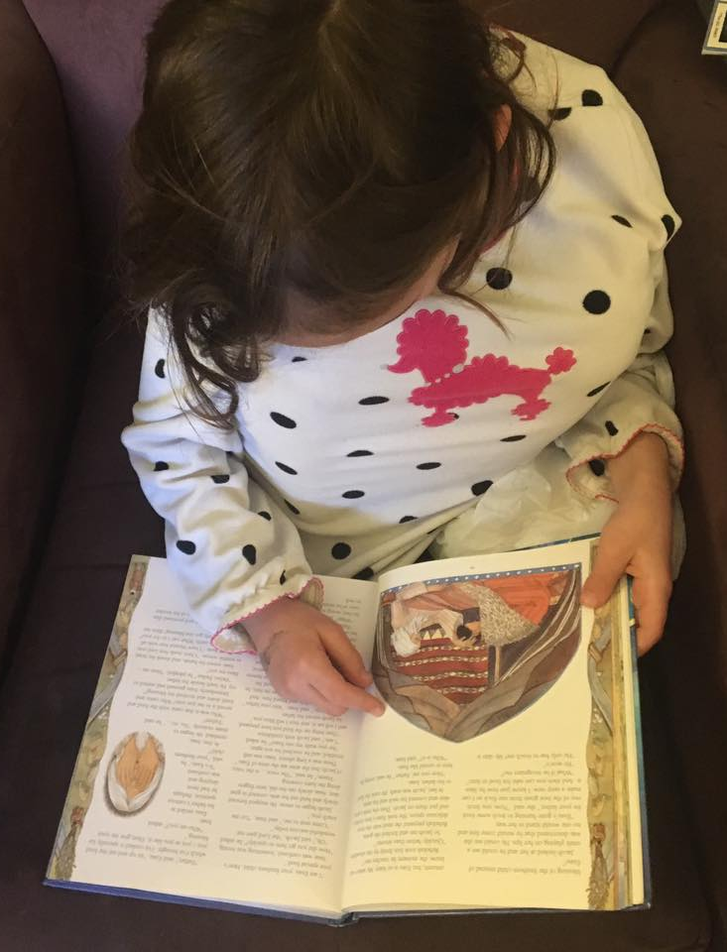
Storytelling
Pixar
  Real risk and danger
  Story clearly and simply told
  Not preachy, moralistic, or obnoxious – engages adults as well as children
  Keep to the essentials – detail enriches main point, doesn’t distract.
  Visual interest
Remember: many children AND ADULTS have little knowledge of the overall arc of the Bible. Telling a story without context can be confusing – who is this Moses guy? What do they need to know for the story to mean something?

Slide 7
Storytelling
“I do believe the stories speak for themselves well - but some kids need more active and hands-on ways to engage them. I would never want a picture of my kid to come across as shaming kids who don't naturally tend to sit and read deeply.”

Slide 8
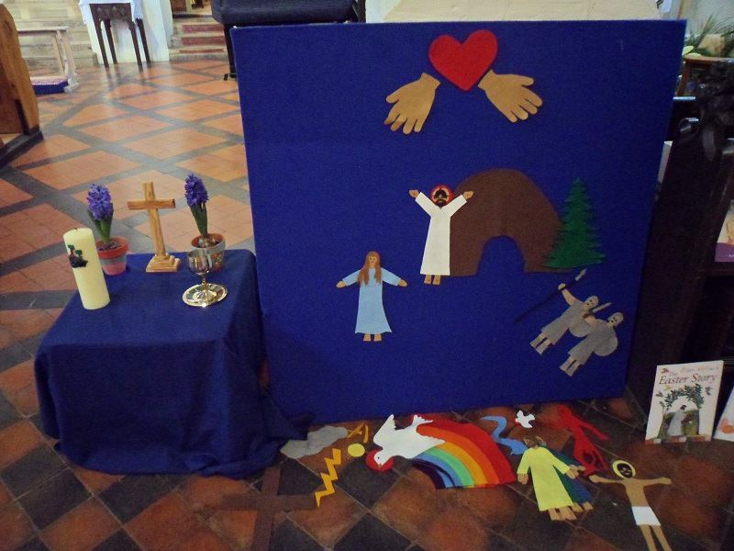
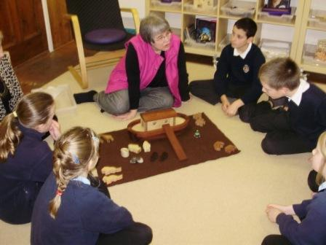
Storytelling
Beulah Land (mustardseedkids.co.uk)
Godly Play (godlyplay.uk)

Slide 9
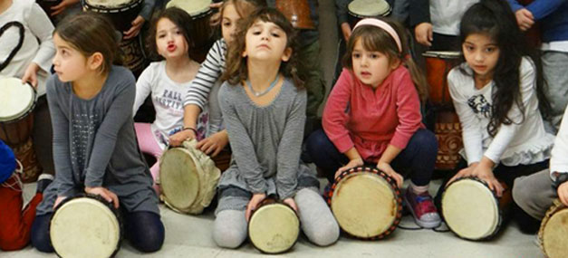
Storytelling
Can two groups of different ages read the story, taking turns?
Can you present the story as a drama?
Can you read the story in two translations – e.g., NRSV and The Message?
Can worshippers physically engage in the story – like Jewish congregations on Purim do?
Are worshippers free to draw during storytelling?
Engagement doesn’t always look the way we think it does.

Slide 10
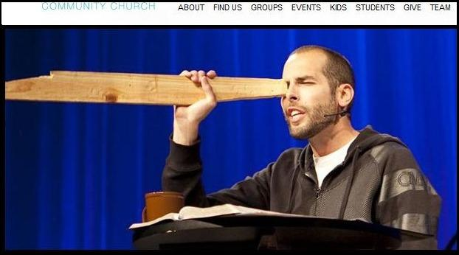
Visual aids are not mandatory
As Pastor Dave began his sermon on judging others, the Health and Safety Officer sadly suffered a fatal heart attack.

Slide 11
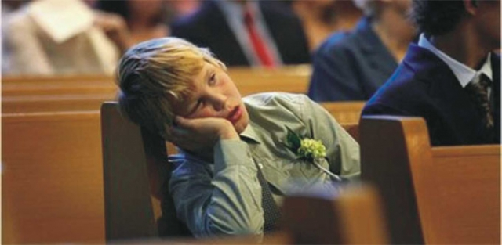
But don’t go so far in the other direction that this happens …
It’s not about extracting a lesson, but wondering/reflecting together.
Work/school – we all share daily lives and similar problems. Relationships, work, inadequacy, anxiety, bereavement, etc. Speak to what’s universal.
It worked for me: Using Godly Play
wondering questions in the sermon, with a roving microphone.

Slide 12
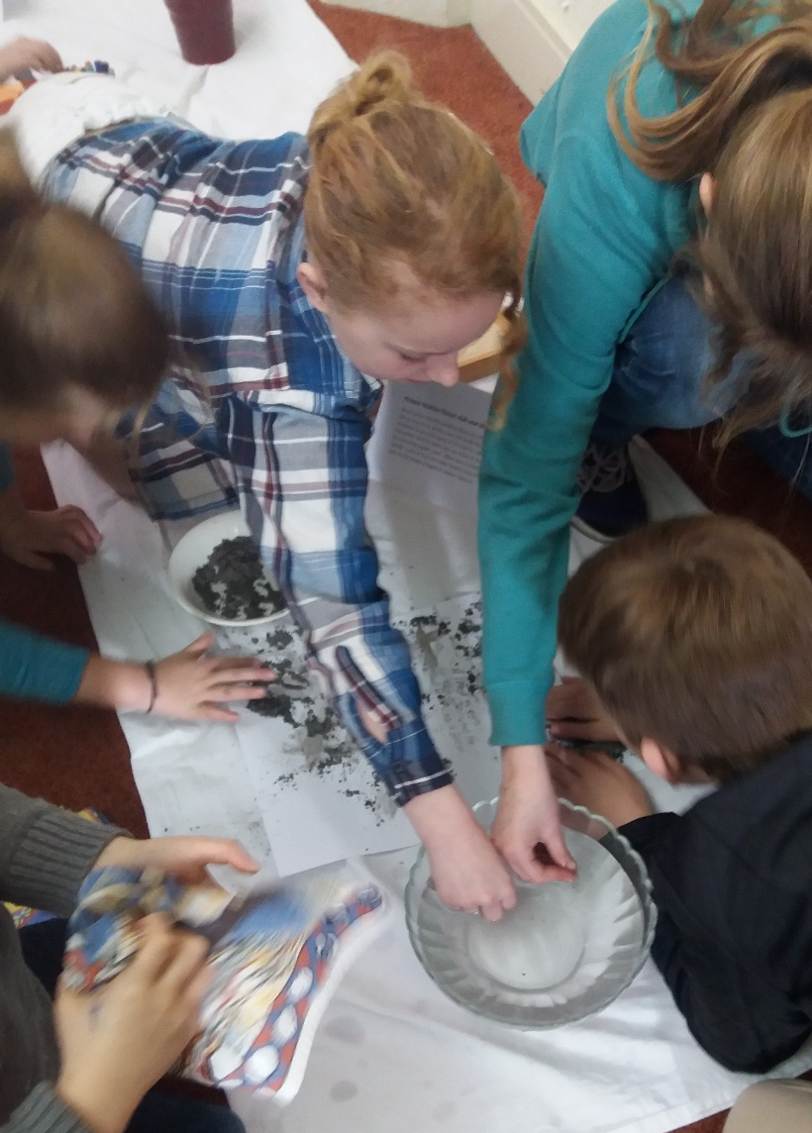
Prayer
Thank you/help/wow – we all have those in common.
Opportunities to touch/draw/write: writing/drawing, touching, shaping something, bubbles, stones, wooden fish, candles, etc.
It worked for me: having an art table available throughout the service, with activities related to that day’s festival. This was in response to complaints from the children that there was “more to do” in Sunday School than in worship.

Slide 13
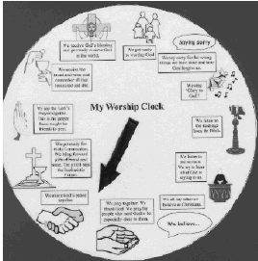
Guiding through the service
Various different formats can be used for different ages – useful for all newcomers.
(This can be found on my All-Age Worship Pinterest board, on your resource list – or on http://www.christiancrafters.com/craft_worship_clock.html)

Slide 14
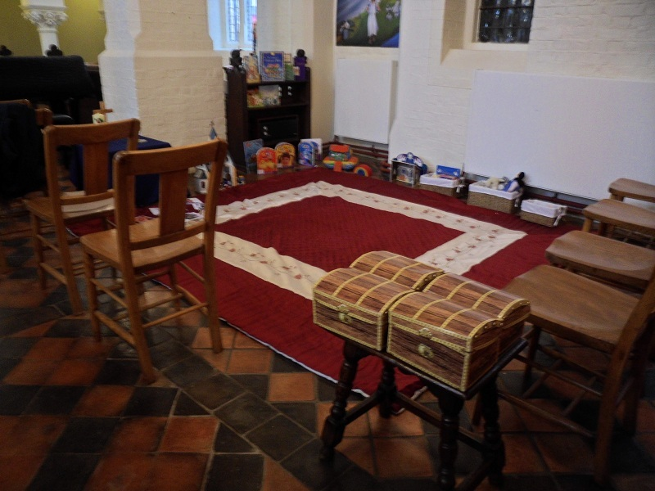
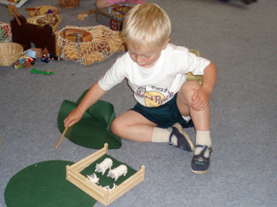
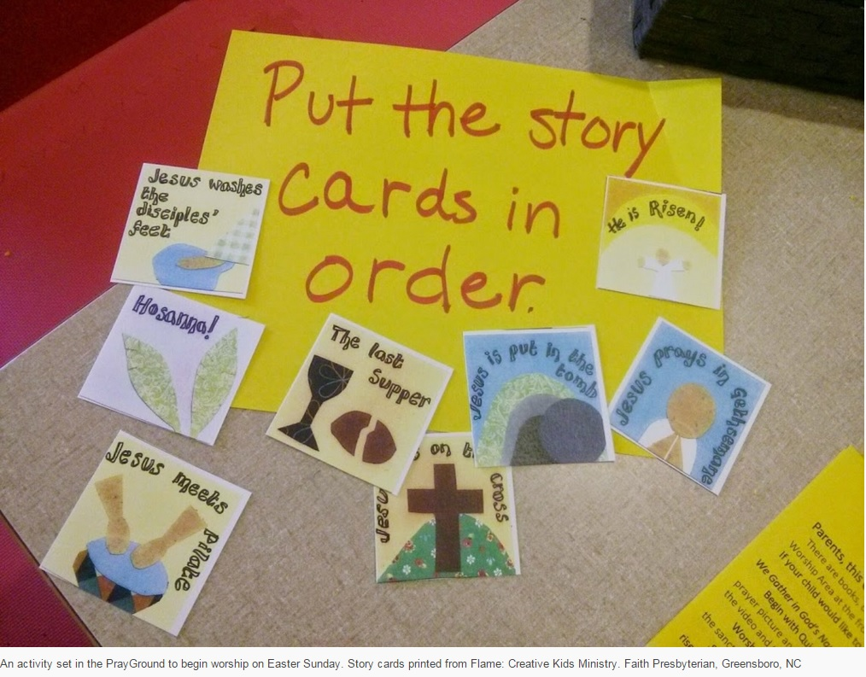
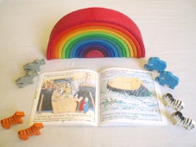
Children’s corners/pew bags

Slide 15
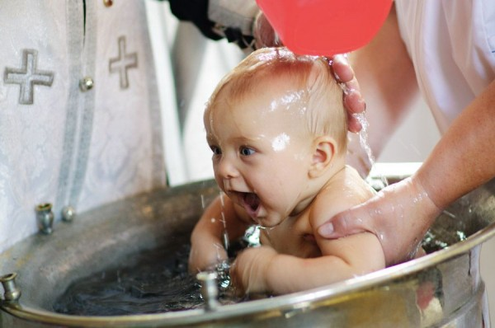
But what is different?
Babies and toddlers:
Free play and ability to move around
Sensory experiences
Copying what adults do
Can they see?
Primary school:
Entering deeply into stories
Imaginative response
Facts and trivia
Pew art
Can they see?

Slide 16
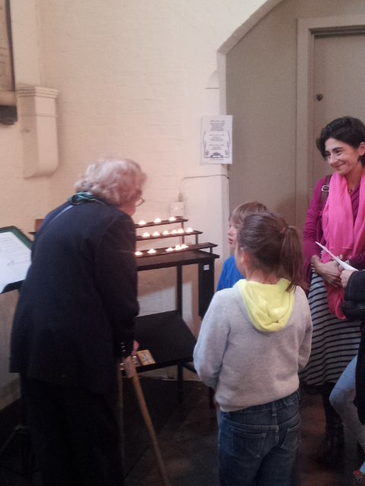
But what is different?
Secondary school:
Social justice
Taking on leadership
Stress of assessments – church needs to be accepting
Doubts and questions
Young adulthood:
Community and authenticity
Parents:
Acceptance and support
Single or childless/child-free adults:
Not being left out in favour of families
Older people:
Being valued
Experienced
History of the church – they hold it.
Sense of civic duty – volunteering, etc.

Slide 17
For all ages:
Think about:
What are they GETTING FROM the service?
What are they GIVING TO the service?

Slide 18
For all ages:
Questions? Comments?
Obvious heresies you spotted?

