Slide 1
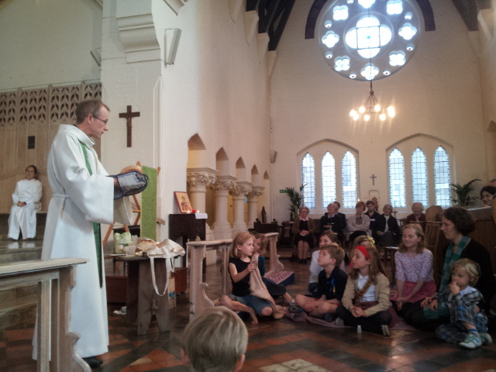

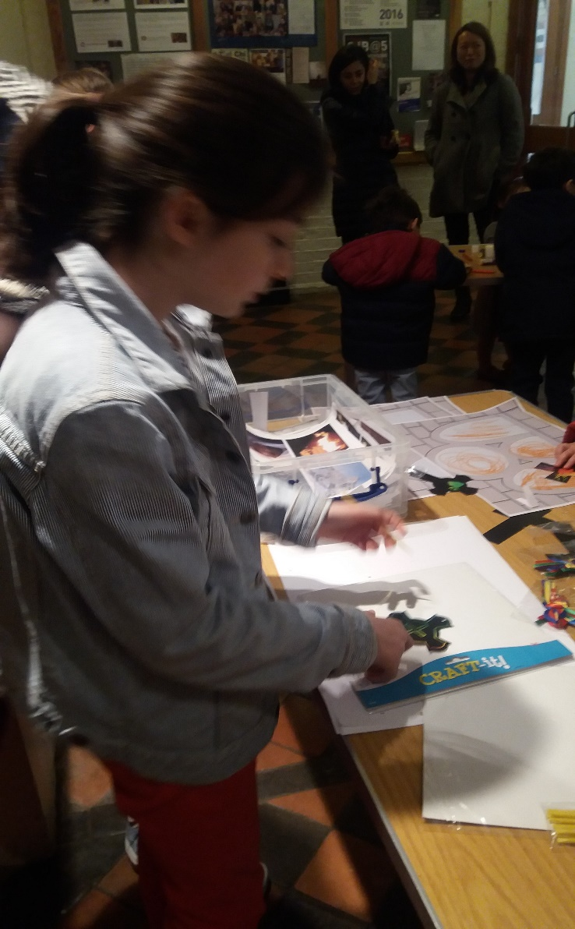
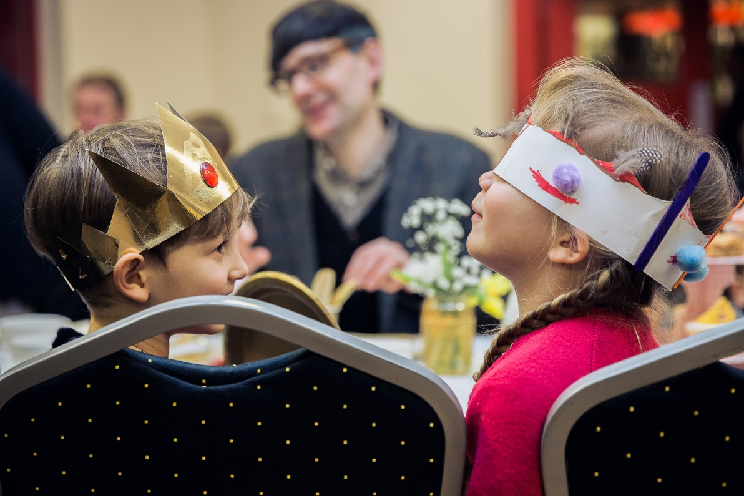

Slide 2
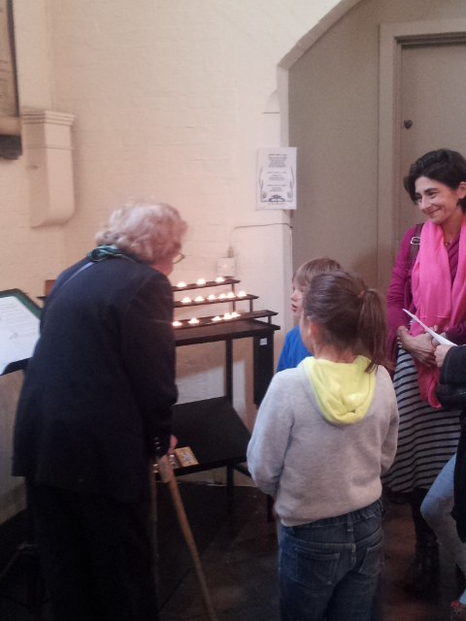
Building on the first steps
Children in worship
Going deeper – storytelling
Making the most of existing contacts
This is not:
An order to do ALL OF THIS NOW OR YOU ARE FAILING AS A CHURCH!!!!!!
An exhaustive list of ideas
The right way for everyone
A foolproof path to success, riches, glory, and bragging rights at Diocesan Synod about how your church is growing by the thousand every week. I wish I had that. I don’t.
This is:
Some stuff to get you thinking (hopefully) and inspired (hopefully)
A set of ideas to take what works for you, change it, and try something.

Slide 3
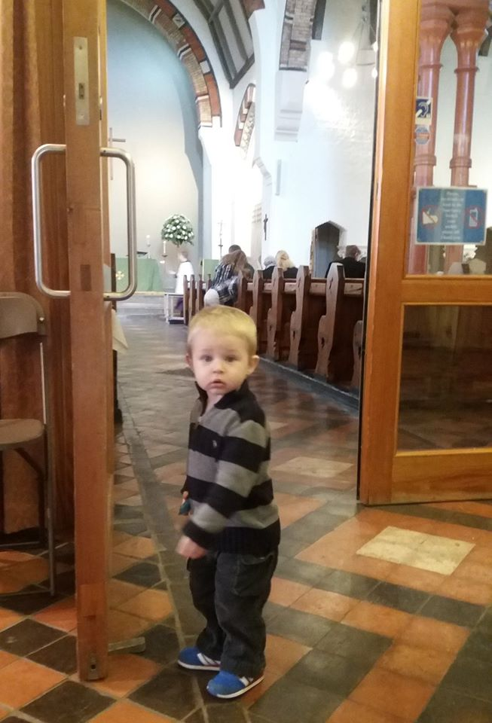
Challenges
“I’m so sorry – we have football on Sunday mornings.”
Blended families and geographical spread – joint custody (weekends in different places), grandparents far away, etc.
Tiny village with few families
Occasional is the new regular.
Church culture
Church space

Slide 4
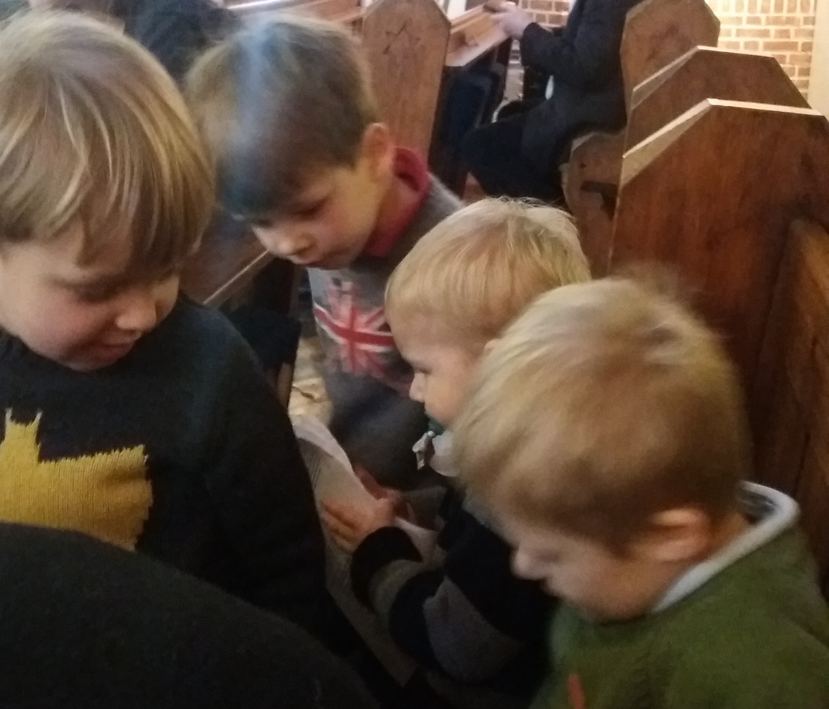
Most common opportunities:
Programmes outside of Sunday mornings
Baptisms
Addressing welcome (culture and space)
Contact with schools – any number of ways to start.
Photo: the William and George story … there are always ups and downs, but relationship matters.

Slide 5
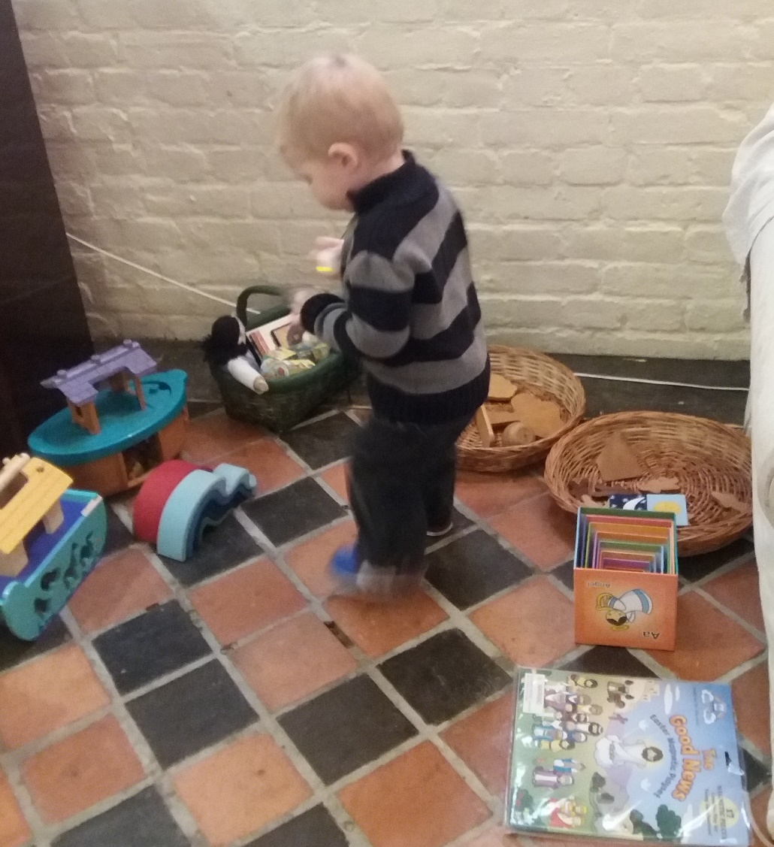
Outside of Sunday morning
Messy Church
Lunchtime or afterschool clubs
Toddler praise
Prayer presence at sporting events
Family services scheduled around local sports groups
Holiday clubs

Slide 6
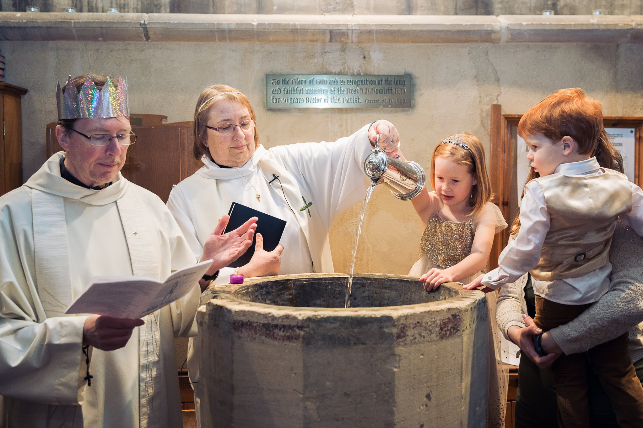
Baptisms
Church of England Christenings: https://churchsupporthub.org/baptisms/
Preparation is key: meeting people other than the vicar and attending a service.
Importance of Godparents
The service itself – warmth and welcome matter more than the exact wording/liturgy.
Follow-up – the Debenhams lesson (Mailchimp)

Slide 7

Children in Worship

Slide 8
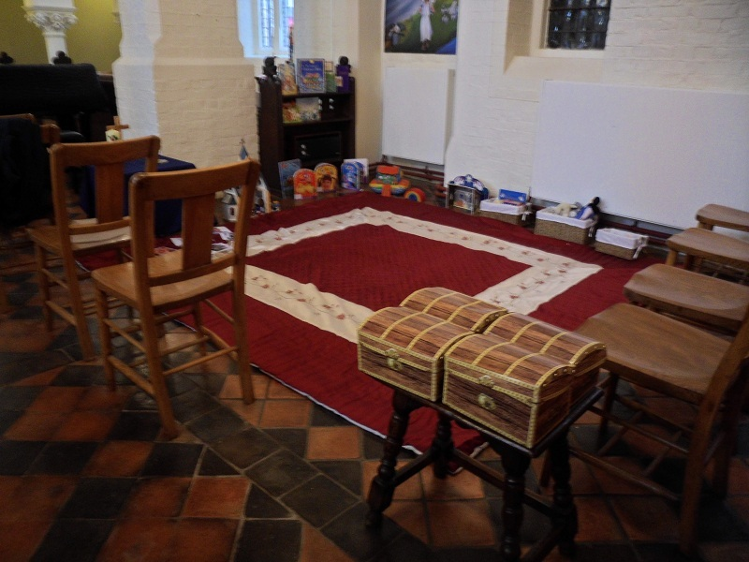
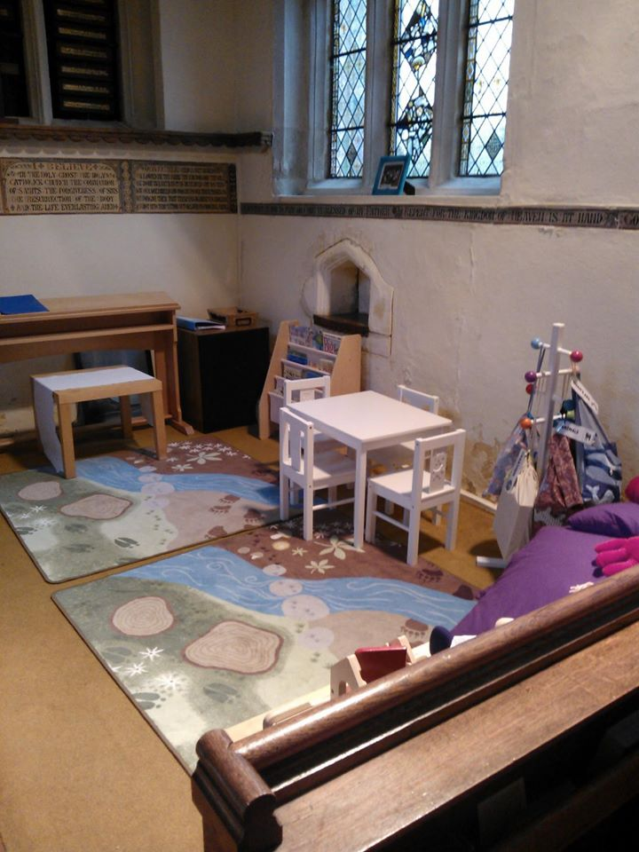
Children’s Corners/Pew Bags
Is the front of the church visible?
Are the toys related to Christian story/liturgy/seasons?
Is it somewhere newcomers/visitors won’t feel exposed?
What age(s) is it for?
Lots of ideas and resources available on the blog – see address below! Search for “Pray and Play.” We also have a leaflet, which I don’t have on hand today … but email me and I can send you a copy.

Slide 9
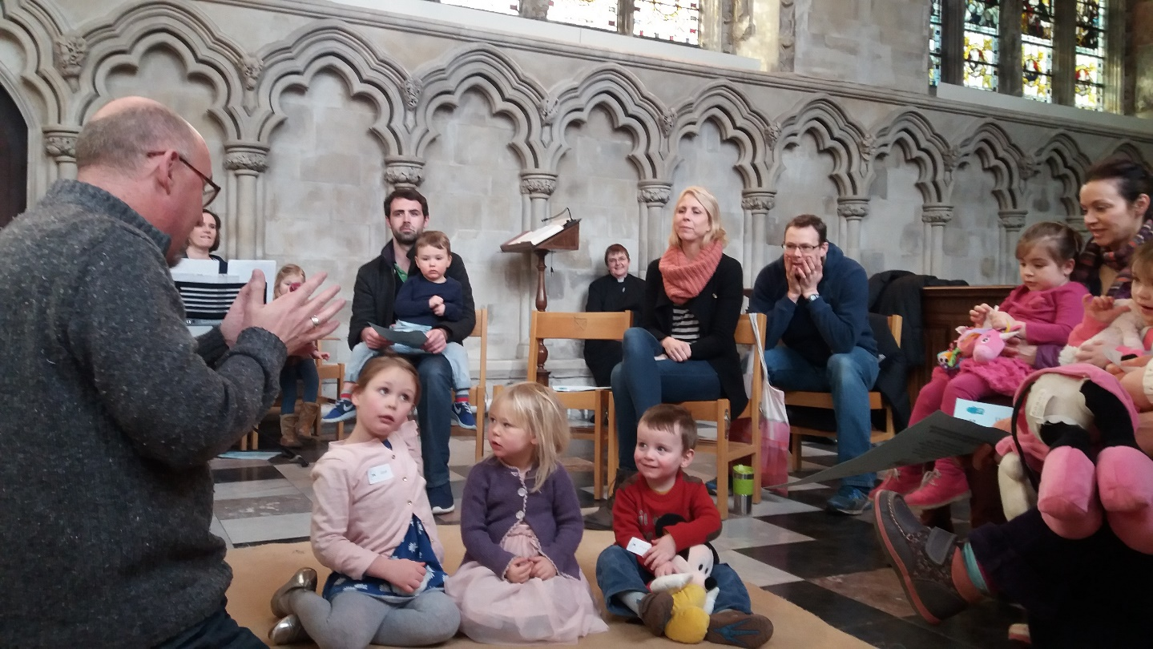
“Ssssshhhhhh!”
“Sound” vs. “noise.” Children do need to be taken out when having tantrums, screaming, etc., but not for the normal sounds of children being children, and ESPECIALLY not for sounds that show active engagement in worship, e.g. “Look at the candles! Pretty! Amen!” (verbatim quote from a 2-year-old in my church a few months ago, which got shushed by an adult worshiper nearby.)
Usual reasons for people being upset with the presence of children in church:
  Pastoral reasons
  Fear

Slide 10
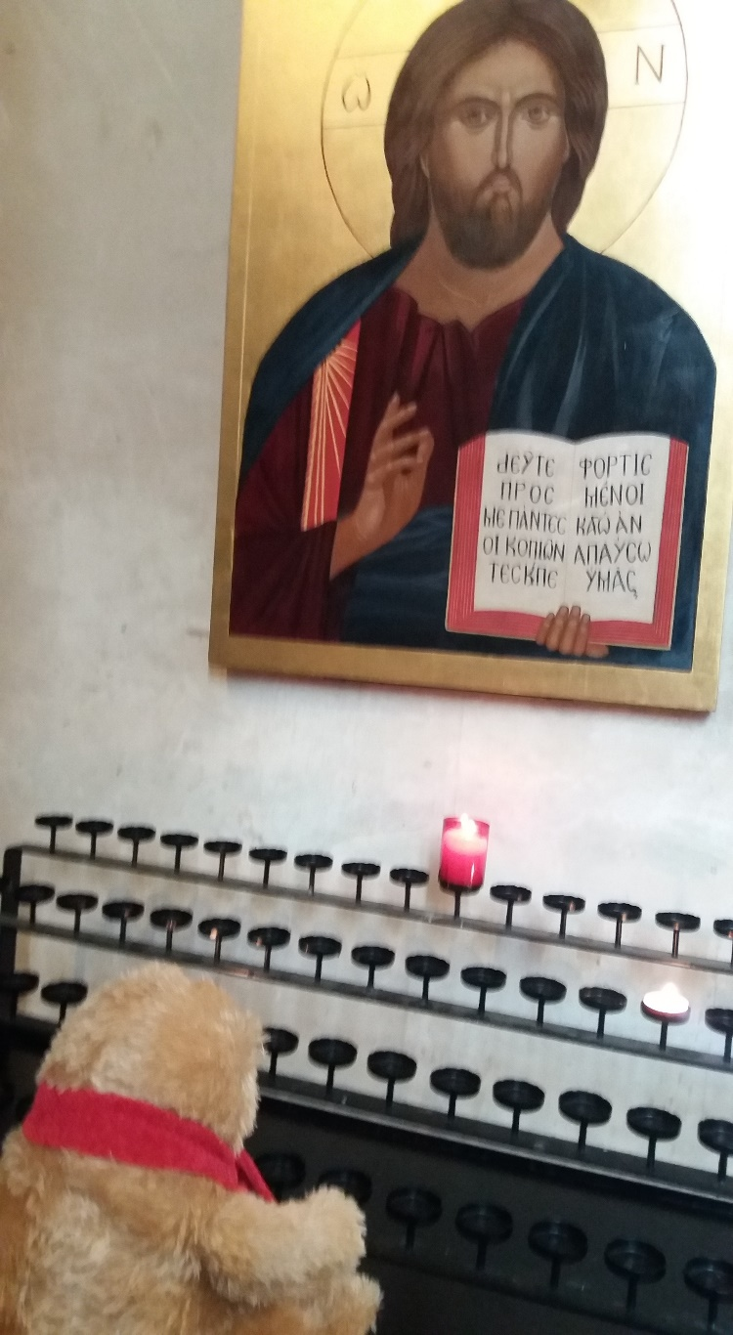
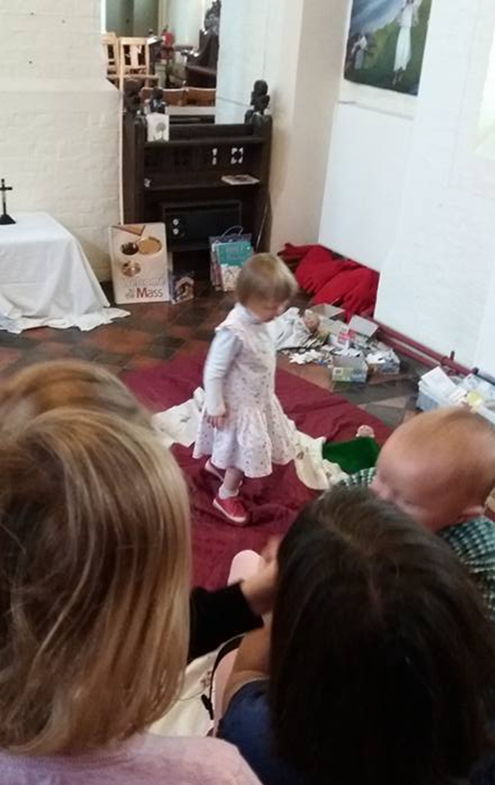
Why the double standard?
Perception that children are ‘guests’ at an ‘adult’ event.
Gretchen Wolff Pritchard
Crucially, this is internalised by PARENTS as well as other worshippers.

Slide 11
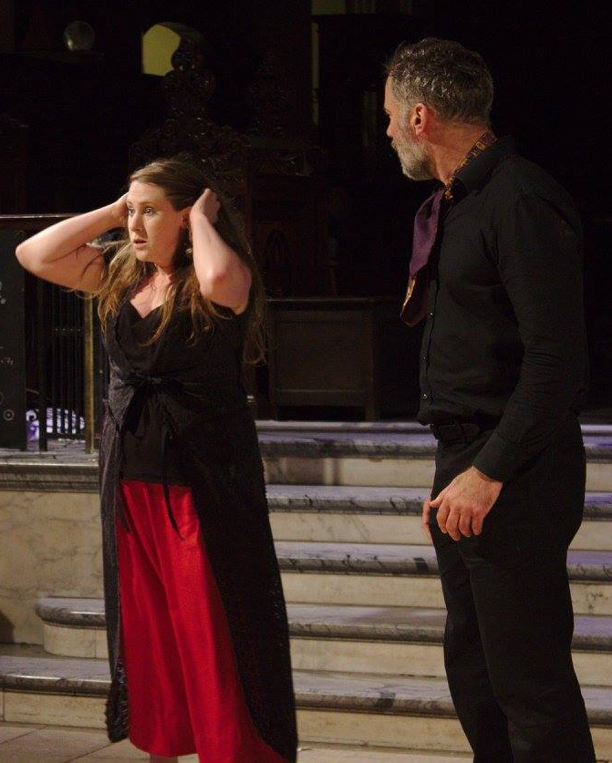
How this assumption affects everyone:
Story: Rehearsal is different
from a birthday party!
Adult worshippers – “children are disrupting an event that’s for me.” They may be more accepting at family events or other occasions where they understand it’s for everyone.
Parents – “my children are misbehaving and bothering the people who this is for. I’m embarrassed and I need to make them behave.” Emphasis on not disturbing others, rather than engaging in the event. Watch these same parents at a children’s puppet show – they behave differently.
Children – “this is not for me. I have to sit down and shut up instead of being actively engaged.”

Slide 12
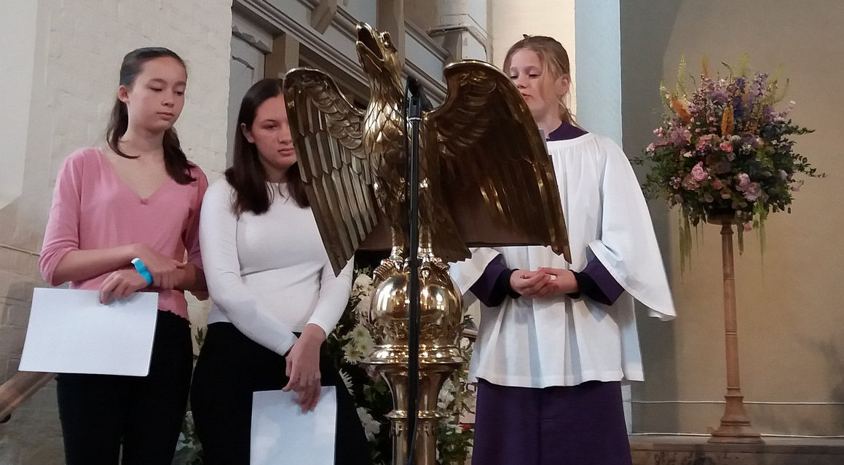
Children/young people as worship leaders:
Real jobs that need doing
Hearing their voices
The Body of Christ is richer when all ages are present
Biblical precedent: Samuel, Jeremiah, David, the boy Jesus in the Temple.
Rooted in the Church report: importance of Holy Communion

Slide 13
For all ages:
What are they GETTING from the service?
What are they GIVING to the service?

Slide 14
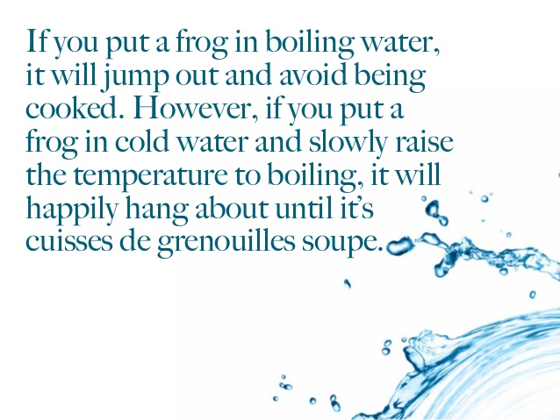
What can be done?
Relationship again: it’s harder to tut at a child you know.
Pastoral reasons behind this behaviour
Frog in boiling water
What else has worked/not worked for you?

Slide 15
Going deeper

Slide 16




STORY
How do we tell these stories to our children?
In order
As stories, not morals
With room for play

Slide 17
The Biblical metanarrative – and how it connects to the other stories we use as guides for growing up.
Fairy tales | Bible
“Once upon a time … | God, creation
“Then the good queen died …” | Fall
“The fairy godmother came …” the various ups and downs of the journey. | People of God
Meeting the Prince | Incarnation, Gospel
Losing the slipper – the promise appears to be broken, hope is gone | Passion
Deus ex machina – the promise is restored, better than it was before. | Salvation
“and they all lived happily ever after.” | Kingdom of God

Slide 18
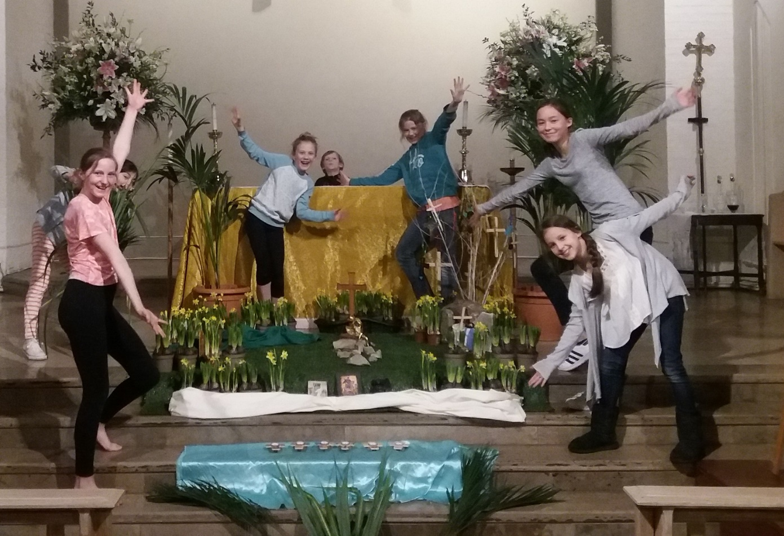
Lots of resources available at the Diocesan Office:
Free to borrow
They can be brought to you if you get in touch
Spiritual Child Network Facebook group
Flame Creative Kids
Mustard Seed Kids (Beulah Land feltboard – conflict of interest alert)
Godly Play
Worship Workshop

