Slide 1

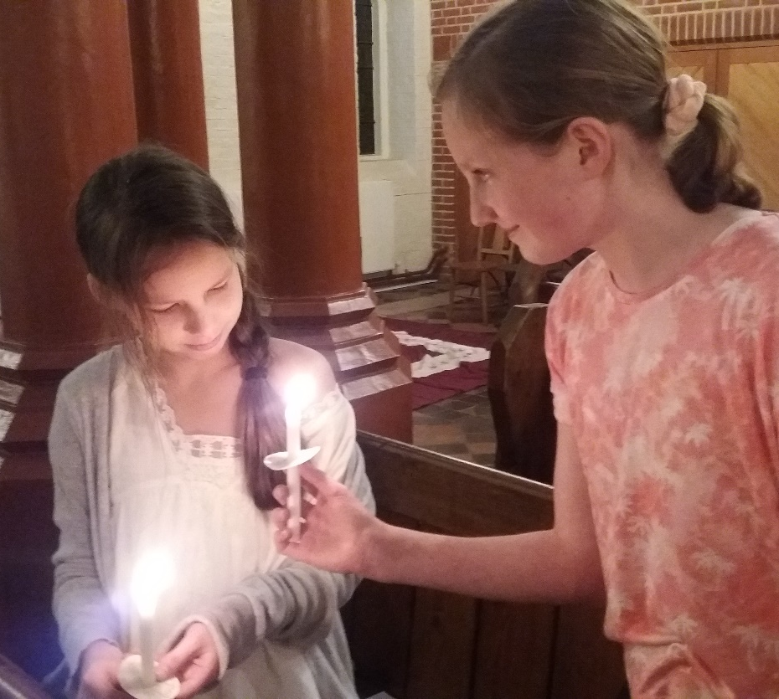
Lay Leaders of Worship
All Age Worship
Margaret Pritchard Houston, Children’s Mission Enabler
Adapted from a session developed by The Revd. Ruth Pyke
01727 818 176
cme@stalbans.anglican.org
Twitter: @stalbanscme
Blog: stalbanscme.com
Facebook: “Children’s Ministry St Albans Diocese”

Slide 2
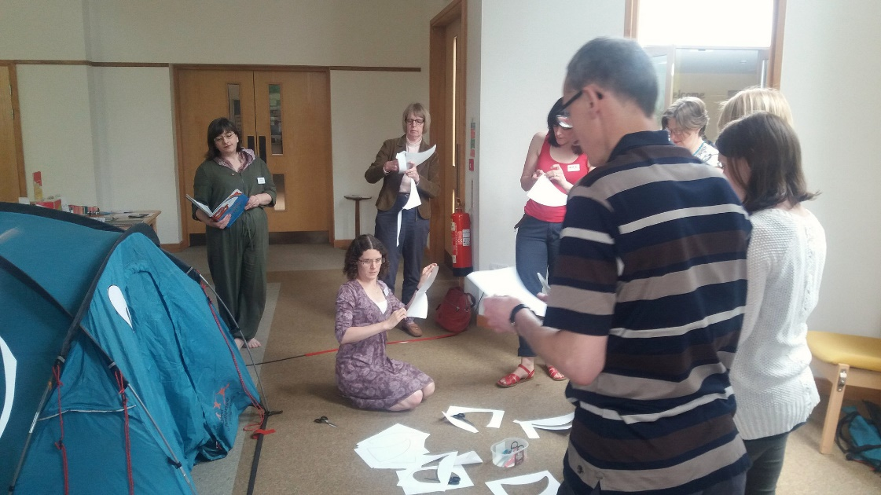

The All-Age Service you attended
What was your reaction? What was engaging? What was difficult or tedious?
What do you think are the main challenges for All-Age Worship? What are the opportunities?

Slide 3

What is All-Age Worship?
What does it mean for a service to be All-Age?
What, if anything, makes it different from a “normal” service?
“If there have to be children there for it to work, by definition, it’s not an All-Age Service.”
– Rev. Mary Hawes, National Children’s Work Advisor to the Archbishop’s Council. Agree? Disagree? A bit of both?

Slide 4
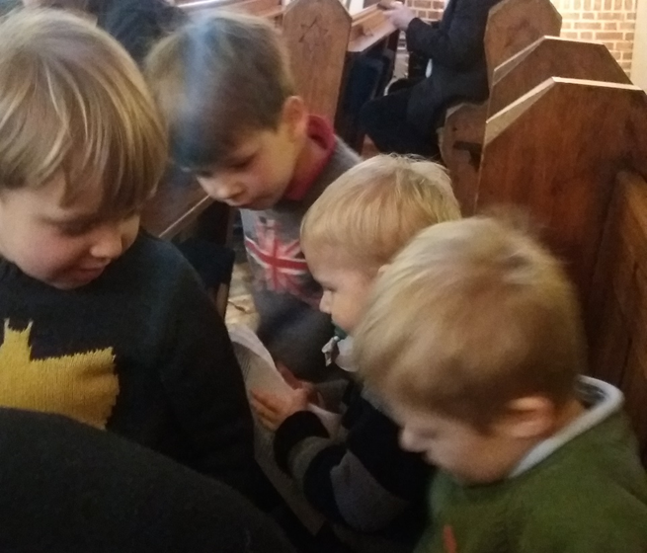
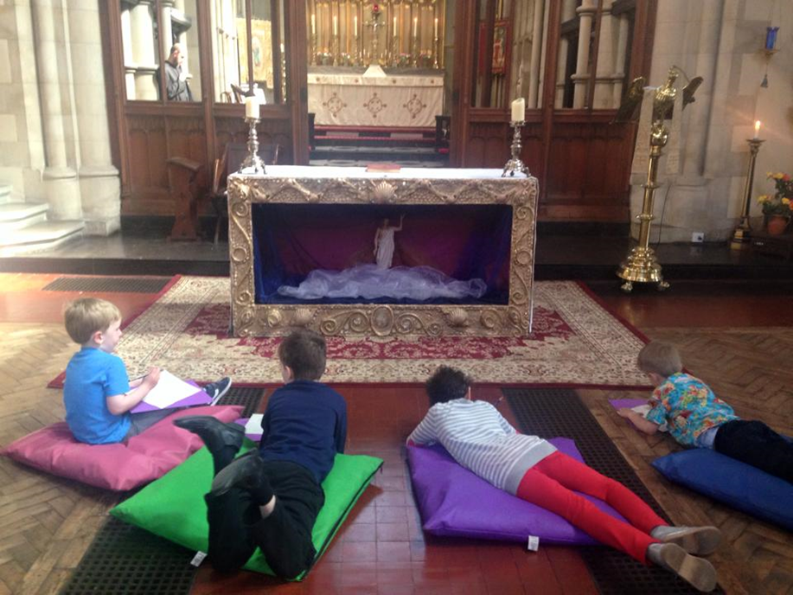
All-Age Services can:
Be interactive
Include children and young people as leaders, along with adults
Be “teaching” – include commentary on what we’re doing and why
Include visual aides, prayer stations, drama, things to touch, movement …
Happen in any style of churchmanship – there can be high-church Anglo-Catholic All-Age Worship just as much as there can be Charismatic Evangelical All-Age Worship. “All-Age” is not a style of worship.

Slide 5

All-Age Services should:
Introduce children in an age-appropriate way to what happens in church, providing them with an experience of enculturation.
Be recognisable to adults who regularly worship at your church as not fundamentally different from “normal” church.
Take children’s spirituality seriously and not talk down to them.
Not require children to “perform cuteness” for adult approval.
Include real spiritual nourishment, not junk food.
Keep it simple. “People need to be reminded more often than they need to be told.”
These last two are not in opposition to one another.

Slide 6
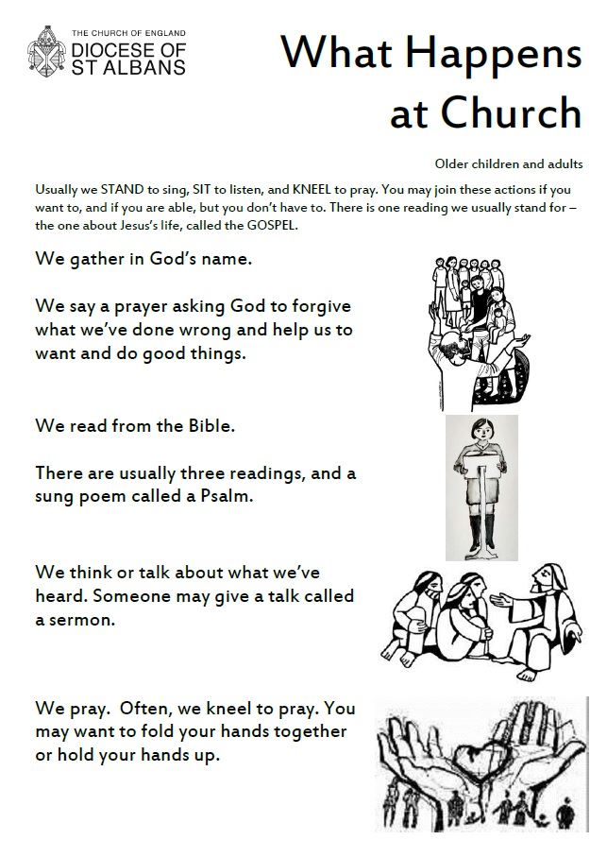

Welcome and greeting
When was the last time you went somewhere new and unfamiliar? How did it feel? What helped/didn’t help you feel welcome?
While All-Age Worship is not just for children, there are specific things you can do to help make children and families in particular welcome.
Those unfamiliar with church culture, or on the autism spectrum, may also find some of these techniques useful.
Available at https://stalbanscme.com/2016/04/25/welcoming-the-stranger/

Slide 7

Welcome and greeting

Slide 8
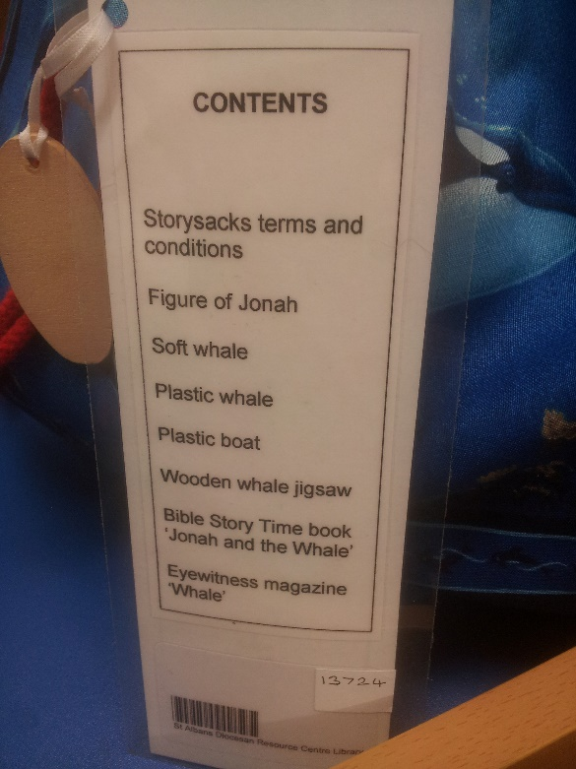
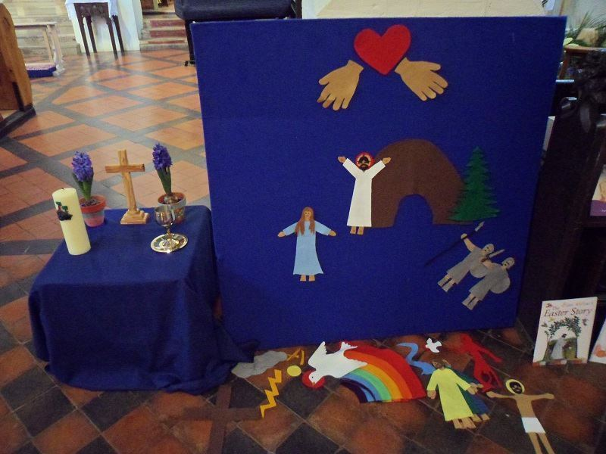
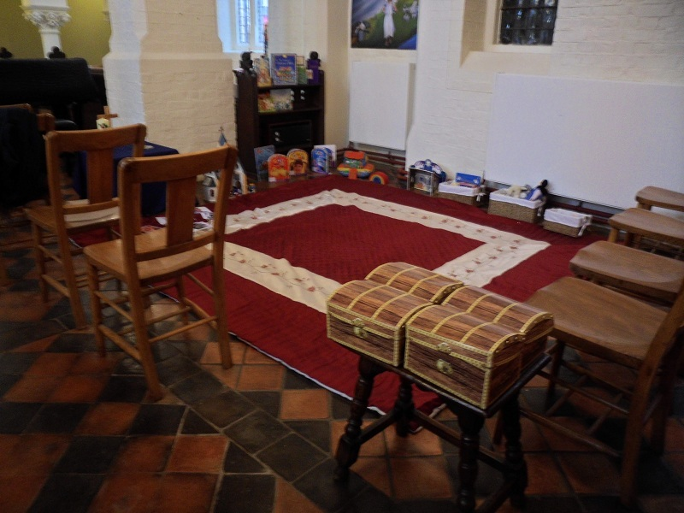
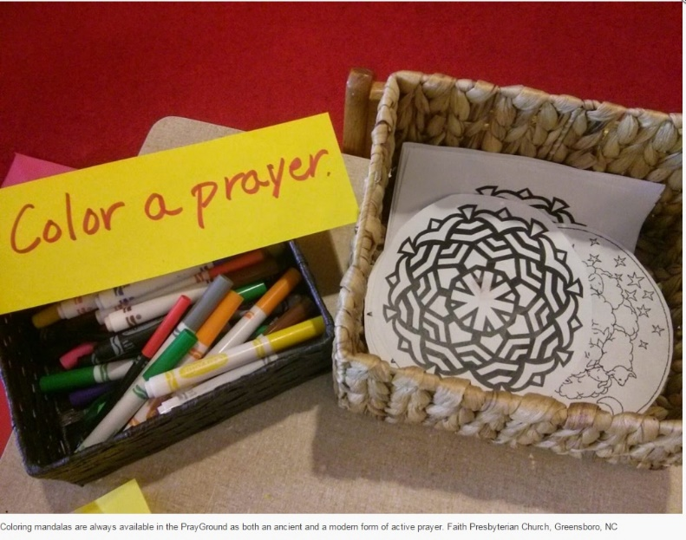
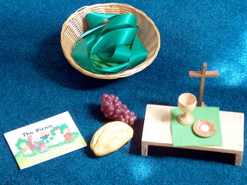
Welcome and greeting
Children’s corners or worship bags

Slide 9
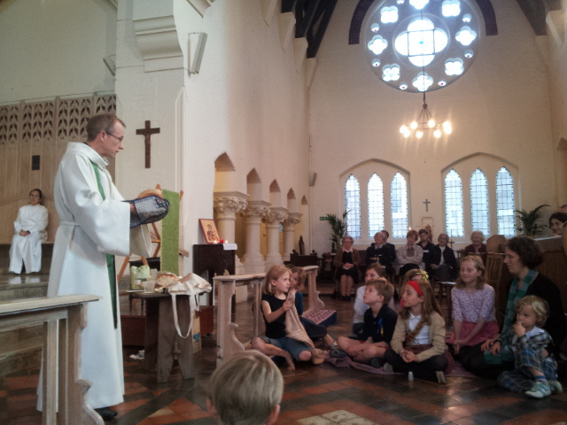
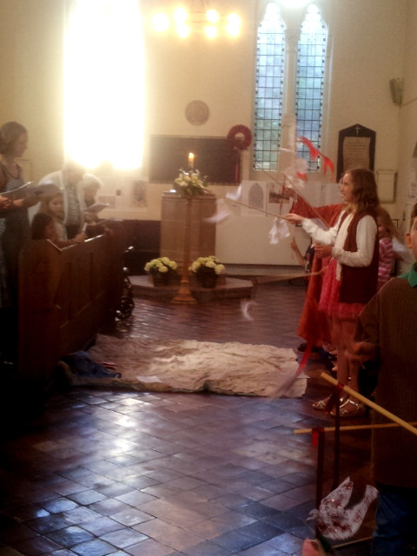
Hymns/Greeting/Response:
Processions – something for children to carry or do
Where do the children sit? Together or with families? Are they given a choice?
Toddlers may have something to do with their hands – connecting objects, etc.

Slide 10
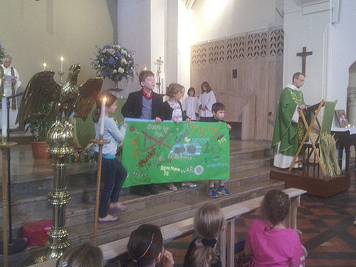
Prayers of Penitence
Authorised forms must be used, but could they be supplemented?
Could the congregation, including children, add specific items? (Not things they’ve done, but things humanity does, e.g. saying hurtful things, polluting, etc.) You could do this by sharing with a neighbour, writing something down as you enter – all kinds of ways.
A visual aide – this is the children’s representation of what’s wrong with the world – bullying, war, murder, etc. Behind it is their vision of how God wants the world to be. One gives way to the other at the absolution.

Slide 11
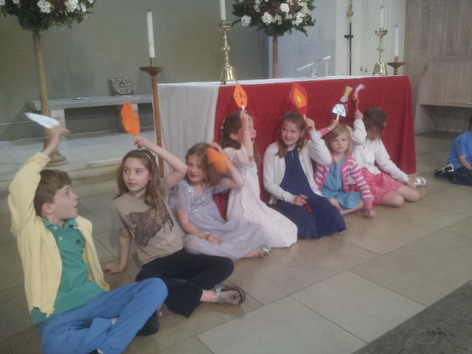
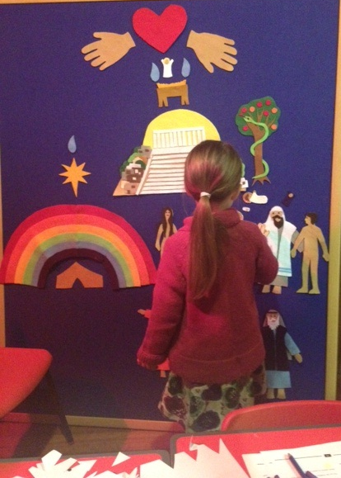
Readings:
Acting out the story (with or without practice), Beulah Land, Godly Play, Bibliologue, Videos, children’s Bibles, words with accompanying actions by congregation …
Could two or more people of different ages lead the readings together?

Slide 12
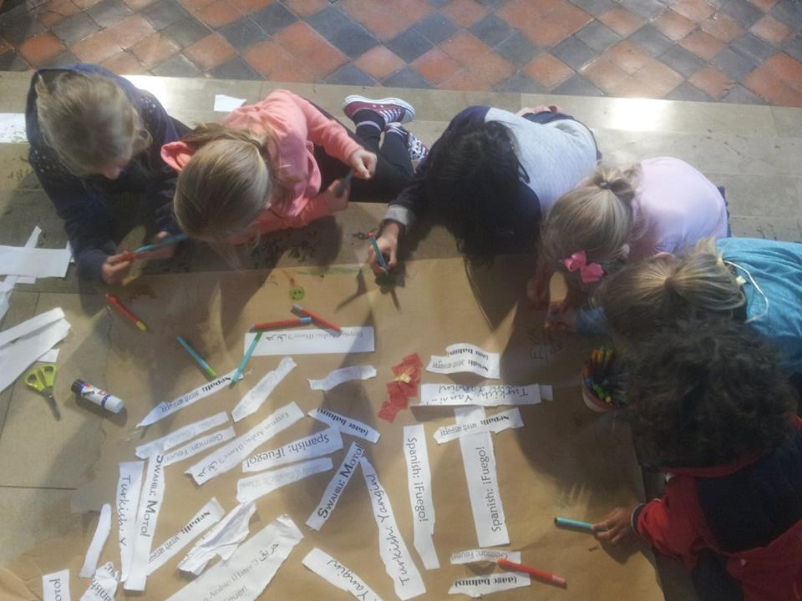
Responding to the Word:
I wonder …
Visual aides?
“Children’s talks”
Could children or young people lead the reflection?
Sermon in the voice of a character in the story
Quiz
Produce artwork in response (think about access)
Group discussions and sharing

Slide 13
Affirmation of Faith (shortest authorised version):
Sung creed from Worship Workshop (link)
Do you believe and trust in God the Father, creator of heaven and earth?
I believe and trust in him.
Do you believe and trust in his Son Jesus Christ, who redeemed the world?
I believe and trust in him.
Do you believe and trust in the Holy Spirit who gives life to the people of God?
I believe and trust in him.
This is the faith of the Church.
This is our faith.
We believe and trust in one God,
Father, Son, and Holy Spirit.
We believe in God the Father, God almighty, by whose plan
Earth and heaven sprang to being, all created things began.
We believe in Christ the Saviour, son of God in human frame,
Virgin born, the child of Mary, upon whom the Spirit came.
Christ who on the cross forsaken, like a lamb to slaughter led,
Suffered under Pontius Pilate, he descended to the dead.
We believe in Jesus risen, heaven's king to rule and reign,
To the Father's side ascended, ‘till as judge he comes again.
We believe in God the Spirit, in one church, below, above:
Saints of God in one communion, one in holiness and love.
So by faith, our sins forgiven, Christ our Saviour, Lord and friend,
We shall rise with him in glory to the life that knows no end.
Beulah Land Apostle’s Creed story – handout.

Slide 14
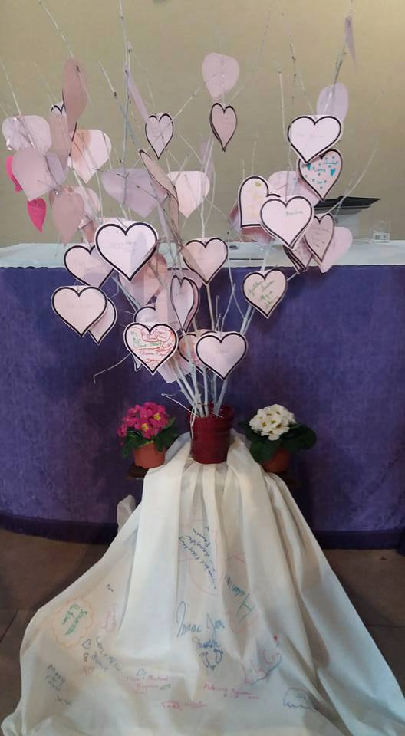
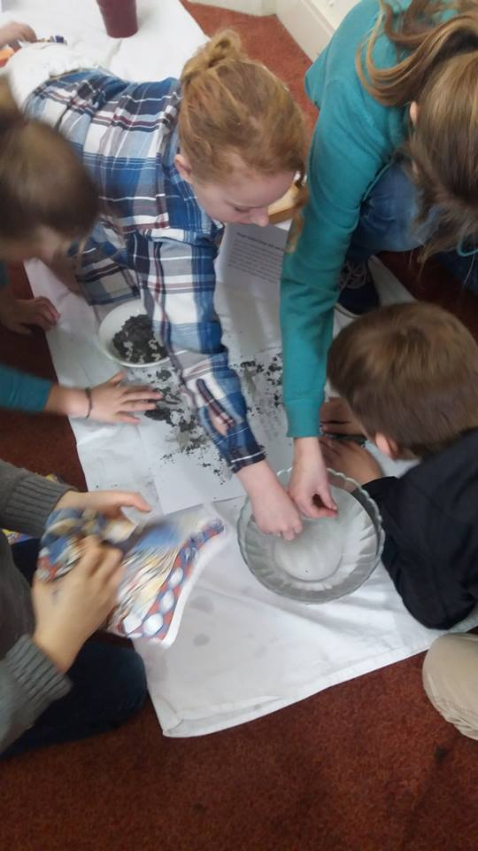
Prayers and Going Out:
Prayer stations – and how to trick high-church Anglo-Catholics into doing them.
Lego prayers, five-finger prayers, etc. (Flame Creative Children’s Ministry has tons)
Music – Taize, Litany of the Saints – handouts
Could children or young people write the prayers?
  Church
  World
  Community
  The needy
  The sick
  The dead

Slide 15
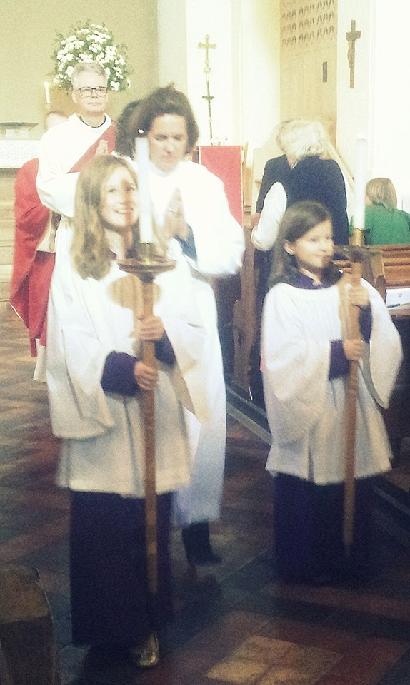
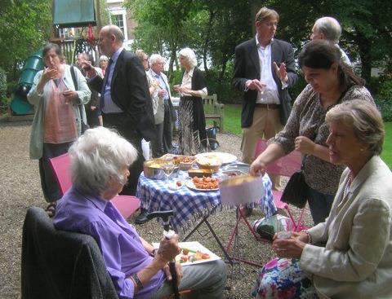
Prayers and Going Out:
The service needs a clear end.
Do you want to provide an item or sheet to take home?
Is there a way of getting contact details?
Time, and space, for children to run around and shout? Seats for those with limited mobility?
Food and “getting to know you” time – make sure there are child-friendly drinks and food choices.
Who will talk to newcomers?

Slide 16
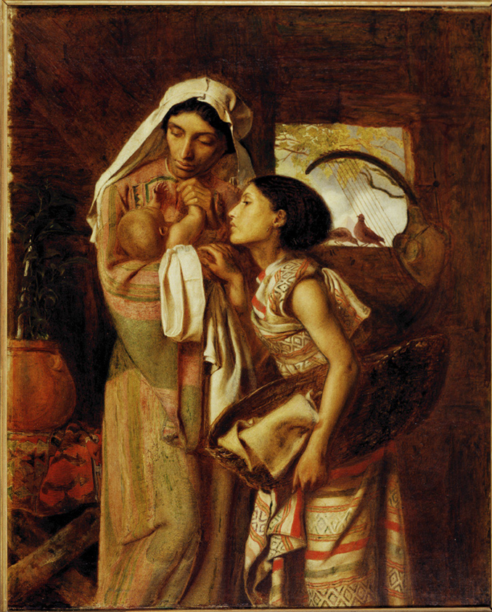
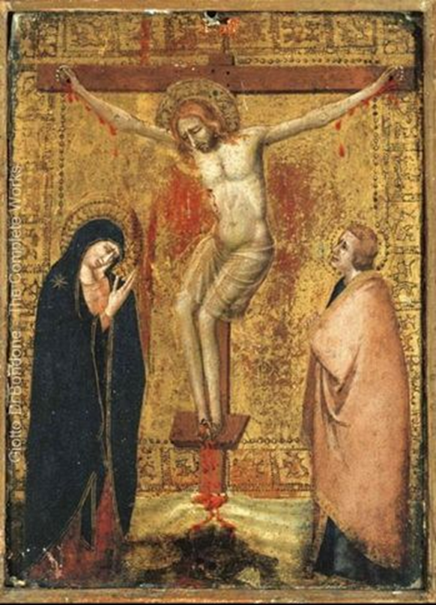
Task: Planning for different spiritual styles – Mothering Sunday
Choose no more than TWO of the elements of worship:
Welcome and greeting
Prayers of penitence
Readings
Responding to the word
Affirmation of faith
Prayers
Going out
Consider how you can plan for all ages, including:
Word
Emotion
Symbol
Action
Consider: what can children do on their own? What can children do with help? What can only adults do?

Slide 17
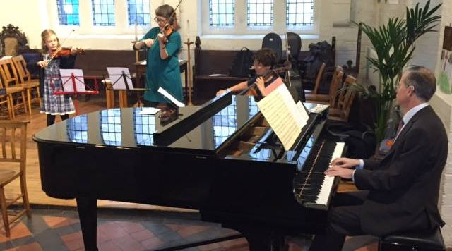

If you’re feeling brave …
Music:
Both Traditional and Contemporary music allows for ease of learning – All-Age doesn’t mean modern music.
Can children participate as musicians? Are there children in your congregation who have pieces prepared for lessons etc.?
  Remember: the purpose here is worship, not performance. Make sure musicians and choristers don’t get the impression that how they sing/play is more important than why they sing/play.

Slide 18
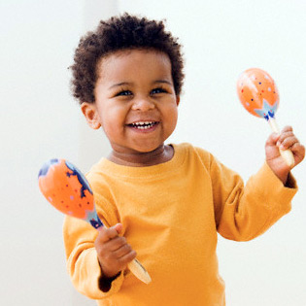

Percussion instruments:
Can be handed out to accompany singing (collect them immediately afterwards)
Can provide sound effects during storytelling
Can be shaken for a particular word/cue (e.g. “Alleluia” on Easter)
Can be shaken to make a simple gospel procession

Slide 19

Silence:
How long will it last?
What should I think about?
Can I be doing something? (Play-dough, drawing, etc.)
Is there a visual focus?
Sand timers or a candle
Sound to begin and end – triangle, etc.

Slide 20

  To sum:
  Use simple language to convey deep truths.
  Credit people of all ages with their own life experiences and their ability to reflect on feelings and emotions.
  Include movement in services, e.g. prayer stations, informal “gospel” procession, suitable hymns might indicate movement (We are marching in the light of God; The Spirit lives to set us free, walk, walk in the light).
  Take note of different spiritual styles.
  Be involved in the planning of the worship if possible.
  Be conscious of what each age group will take way from the service.
  Beware the idea of “entertaining” children – we are all at worship to encounter God.
  Think carefully about applause. Is it just for children and when is it suitable?
  Refer back to the ideas of this session and use them as a springboard for your own imaginative process.

Slide 21
Don’t forget …
1. Reflection
2. Attendance register

