Slide 1
The Nativity
Jesus is Born
Text from Miracle Maker, by Mary Joslin

Slide 2
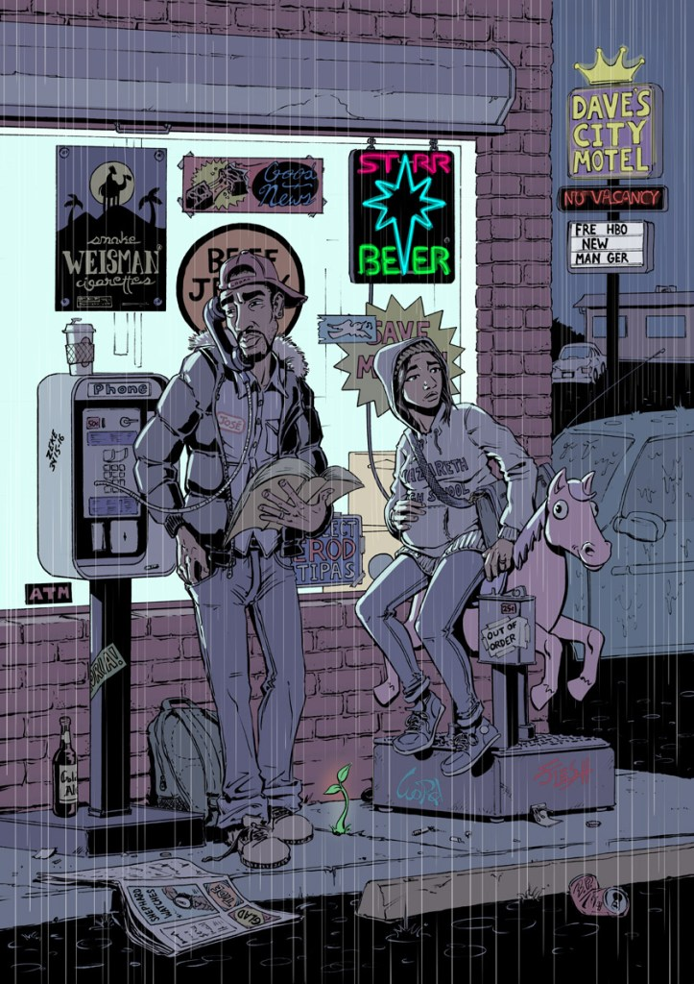
Mary was heavily pregnant now, and so tired. Then the pains of labour were upon her – it seemed certain that the baby was going to be born while she was far away from home, here, in Bethlehem. “Oh, Joseph,” she cried. “We have travelled so far and need a place to stay, but all the rooms for travellers are full. What shall we do?”
Jose y Maria, by Everett Patterson

Slide 3
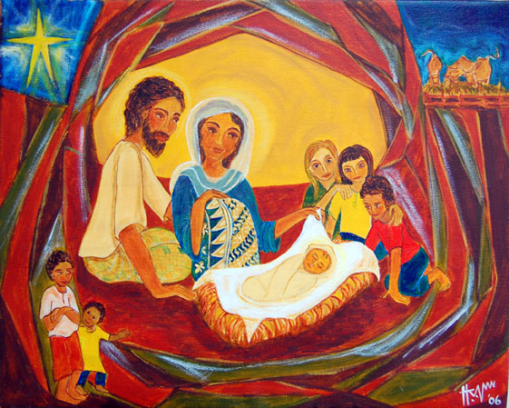
Joseph was not dismayed. Months earlier, in a dream, the angel told him to take care of Mary and her baby. He must now do what he thought best – and trust God that all would be well.
“Dear Mary,” he said, “here is a stable where we can shelter. There is clean straw, enough room to lie down, and the cold night breezes cannot chill us.”
Hanna Varghese, God Is With Us

Slide 4
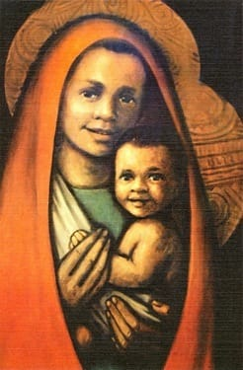
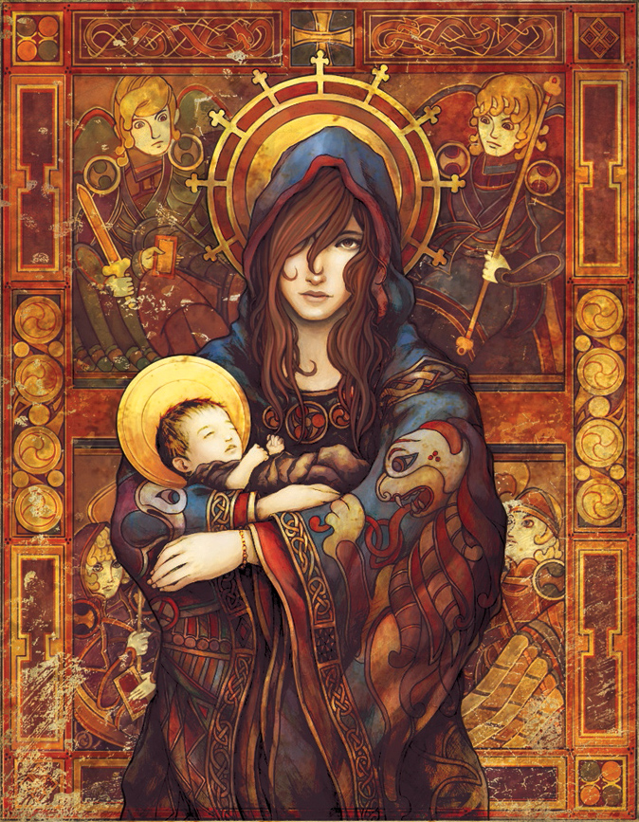
There, among the animals, Jesus was born. The son of God. Not in a palace or a safe hospital, but in a stable. Mary wrapped her baby in swaddling clothes. Joseph piled straw into an ancient stone manger, to make it into a cradle. There, Mary laid her baby.

Slide 5

Some hints:
The signs in the shop window
The motel sign
What is Mary sitting on?
The shapes behind Mary and Joseph’s heads
The graffiti on the side of the telephone
The plant in the pavement (look up Isaiah 11:1-3)
The adverts on the bottom of the paper in the gutter
The writing on Mary and Joseph’s clothes
Anything else?
Look carefully at this picture. How many secret symbols of the Christmas story can you find?

